Slide 1


Case Study 1
Feature Engineering
ML & AI for Data Scientists
(2021)
Sebastian Stein
drsstein.github.io
@ssteinuk
Scan to access these slides on Google Drive or go to https://tinyurl.com/sp7ky24w
Notes:
Scan the QR code to access the latest version of these slides or follow the url!
https://tinyurl.com/sp7ky24w

Slide 2
Overview
Case Study 1
What is Feature Engineering?
Feature Selection
Filtering Methods
Wrapper Methods
Embedding Methods
Feature Extraction

Slide 3
Overview
Case Study 1: Predicting Central Neuropathic Pain
What is Feature Engineering?
Feature Selection
Filtering Methods
Wrapper Methods
Embedding Methods
Feature Extraction

Slide 4
Predicting Central Neuropathic Pain
Approximately 50% of people with Spinal Cord Injury (SCI) have Central Neuropathic Pain (CNP).
Pain in response to non-painful stimuli, episodic (electric shock), “pins and needles”, numbness
There is currently no treatment, only prevention
Preventative medications have strong side-effects

Slide 5
Predicting Central Neuropathic Pain
Approximately 50% of people with Spinal Cord Injury (SCI) have Central Neuropathic Pain (CNP).
Pain in response to non-painful stimuli, episodic (electric shock), “pins and needles”, numbness
There is currently no treatment, only prevention
Preventative medications have strong side-effects
Predicting whether a patient is likely to develop pain is useful for selective treatment
Manual assessment is time-consuming, error-prone and somewhat subjective
There is some evidence that brain Electroencephalogram (EEG) data has characteristic markers
We have a (small) dataset with EEG from SCI patients, of which some later developed CNP
The data is extremely high-dimensional, so it is very hard for a classifier to tell them apart

Slide 6
Predicting Central Neuropathic Pain
Approximately 50% of people with Spinal Cord Injury (SCI) have Central Neuropathic Pain (CNP).
Pain in response to non-painful stimuli, episodic (electric shock), “pins and needles”, numbness
There is currently no treatment, only prevention
Preventative medications have strong side-effects
Predicting whether a patient is likely to develop pain is useful for selective treatment
Manual assessment is time-consuming, error-prone and somewhat subjective
There is some evidence that brain Electroencephalogram (EEG) data has characteristic markers
We have a (small) dataset with EEG from SCI patients, of which some later developed CNP
The data is extremely high-dimensional, so it is very hard for a classifier to tell them apart.
Can feature engineering help to predict - better than random guessing - who later develops CNP?

Slide 7
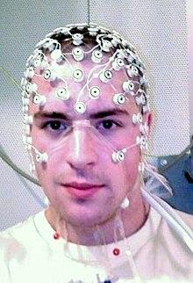
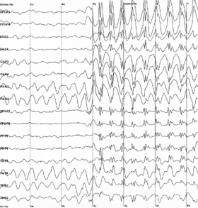
What is Electroencephalogram (EEG)
Notes:
https://en.wikipedia.org/wiki/Electroencephalography

Slide 8
Case Study 1: Dataset
Participants: N=18
8 participants did not develop CNP within 6 months after data collection (PNP)
10 participants developed CNP within 6 months after data collection (PDP)
Data Collection
48 electrode EEG, recording electrical activity of the brain at 250 Hz
participants were asked to relax with eyes closed (EC) and eyes opened (EO)
Segments of data with 5 second length were recorded with 10 repetitions per participant
180 labeled data points (18 participants with 10 repetitions each) are available in total
Notes:
https://en.wikipedia.org/wiki/Cross-validation_(statistics)#Leave-one-out_cross-validation
https://en.wikipedia.org/wiki/Receiver_operating_characteristic

Slide 9
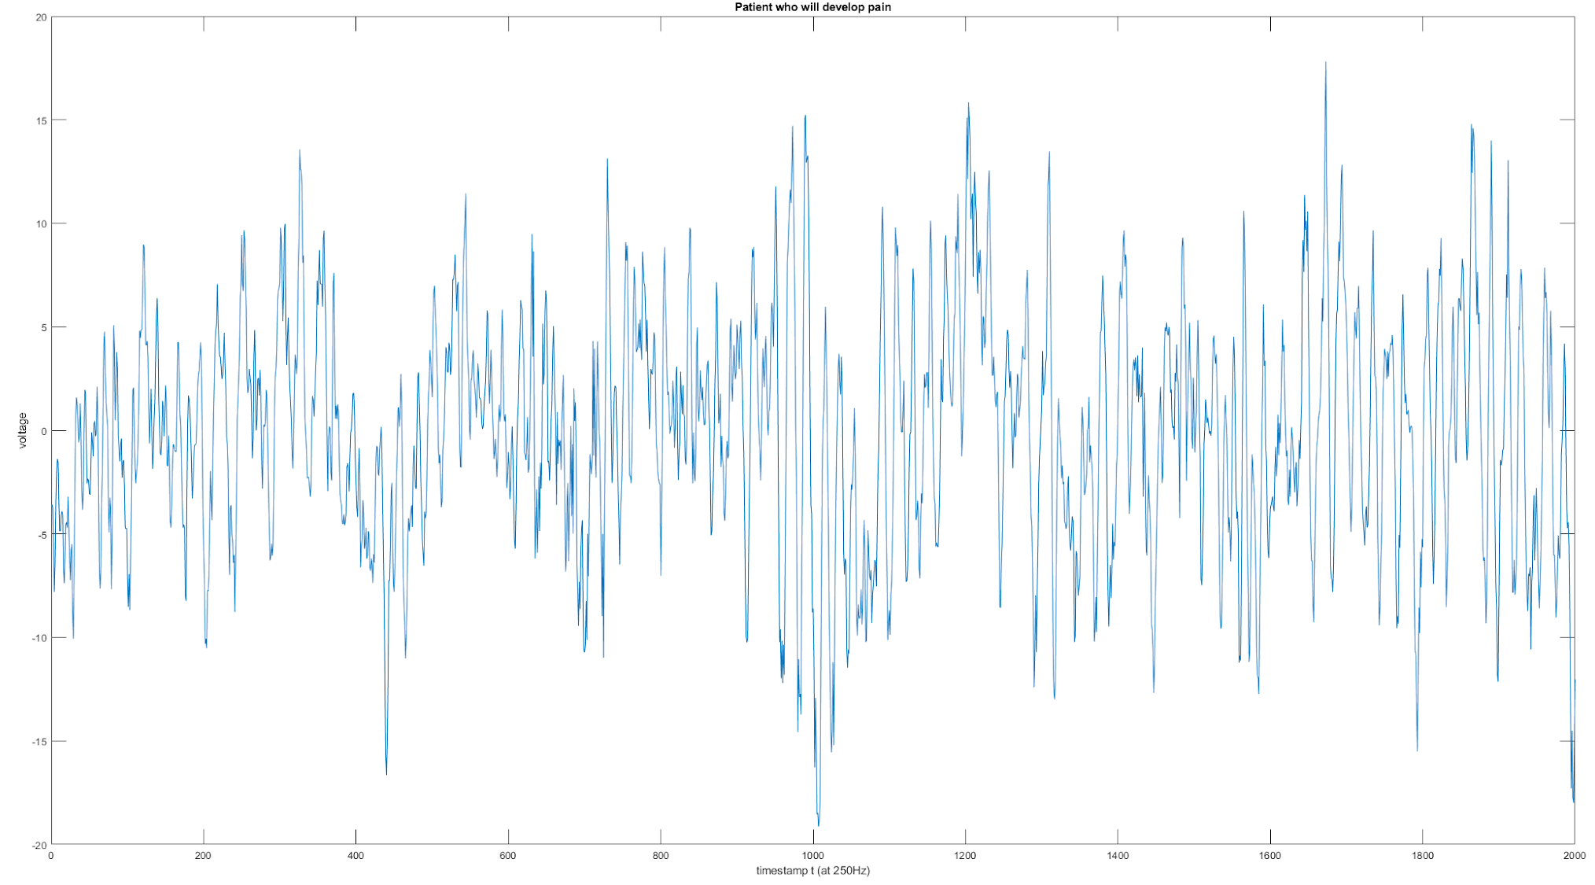
Raw Data - Single Electrode
Notes:
The raw data represents voltage measured 250 times per second at each of 48 electrode location
This is data from one electrode from a patient who will develop pain

Slide 10
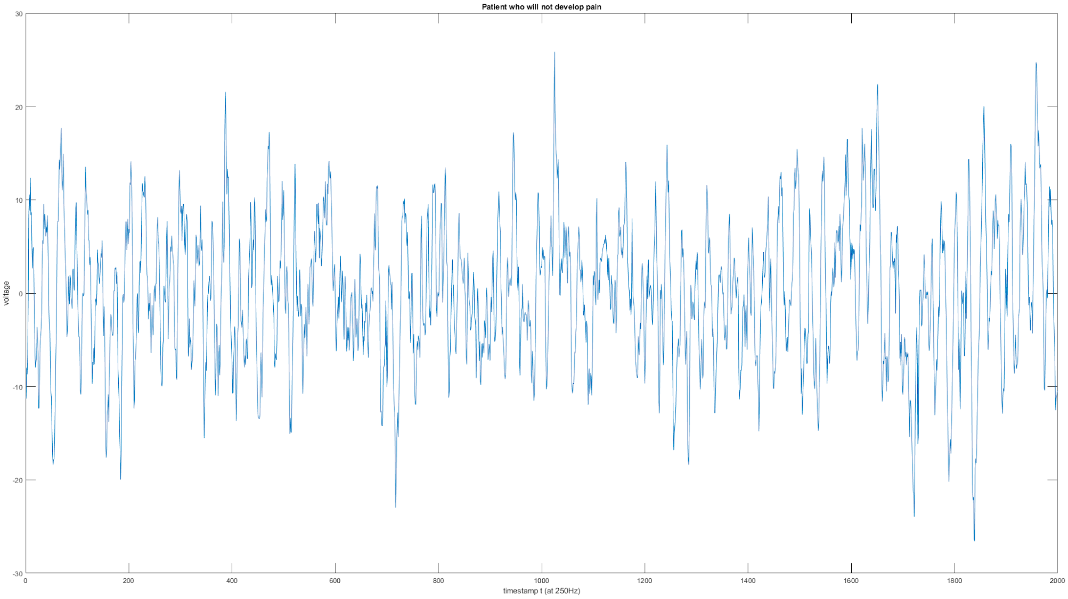
Raw Data - Single Electrode (2)
Notes:
The raw data represents voltage measured 250 times per second at each electrode location
This data is from the same electrode but a different patient (who will not develop pain)

Slide 11
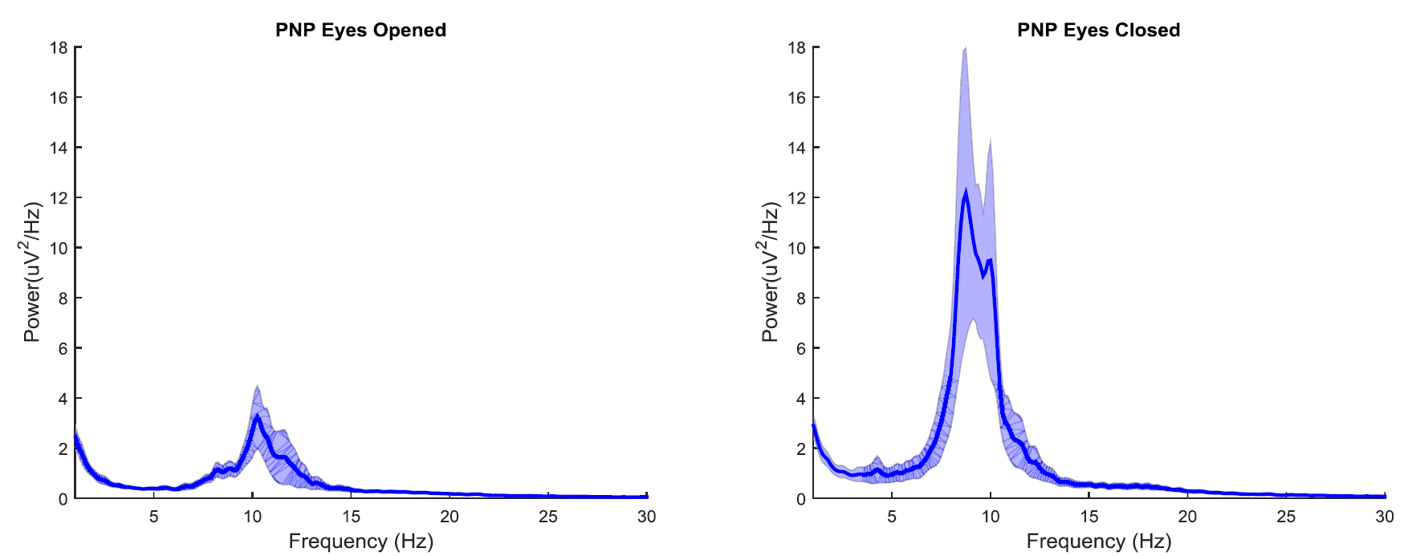
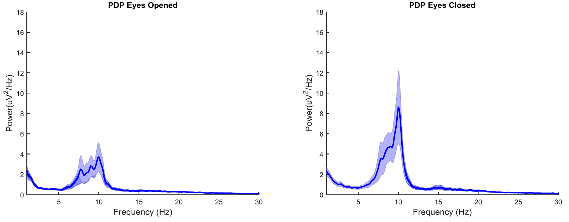
Frequency Spectrum
Notes:
EEG data is usually analyzed in the frequency domain.
This is the frequency spectrum of the raw data, showing the mean and standard deviation of signal power across frequency bands.

Slide 12
Frequency Spectrum (2)
Notes:
EEG data is usually analyzed in the frequency domain.
This is the frequency spectrum of the raw data, measuring signal power across frequency bands.

Slide 13
Frequency Band Power
𝜃
𝛼
𝛽-band
Notes:
Within the frequency spectrum, data is often aggregated to estimate
the power within frequency bands of interested
The normalized band power (bandpower divided by total power)
The ratio between bandpower in eyes opened and eyes closed state
See for further reading https://raphaelvallat.com/bandpower.html

Slide 14
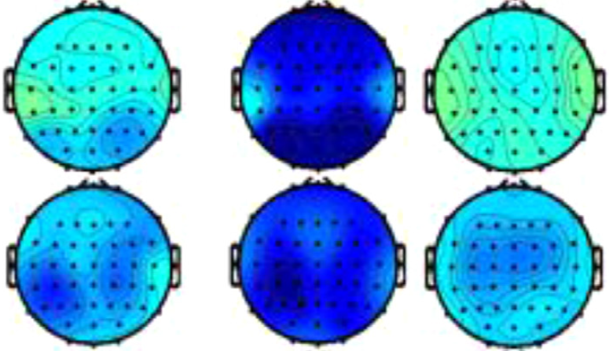
Case Study 1: Bandpower by Electrode Position
Theta
Alpha
Beta
PNP
PDP
Notes:
Bandpower variation across the skull within each frequency band.
Electrical activity on the surface of the skull records aggregate activity across a small brain region. Neighboring electrodes capture overlapping information.

Slide 15
Case Study 1: Task
Your task is to devise a feature engineering strategy.
Data
preprocessing already applied
signal denoising and normalization
temporal segmentation
frequency band power estimation
180 rows (18 subjects x 10 repetitions) x 432 columns (9 features x 48 electrodes)
Objective Measure
Leave one subject out cross-validation accuracy, sensitivity and specificity
Report
Describe feature engineering strategy and give evidence for why your strategy is better than others.
Notes:
The goal is to come up with a (combination of) feature engineering technique(s) that maximises cross-validation accuracy.
Leave one subject out cross-validation means removing a contiguous block of 10 rows from the training data
See https://en.wikipedia.org/wiki/Sensitivity_and_specificity for definition of sensitivity and specificity

Slide 16
Overview
Case Study 1
What is Feature Engineering?
Feature Selection
Filtering Methods
Wrapper Methods
Embedding Methods
Feature Extraction

Slide 17
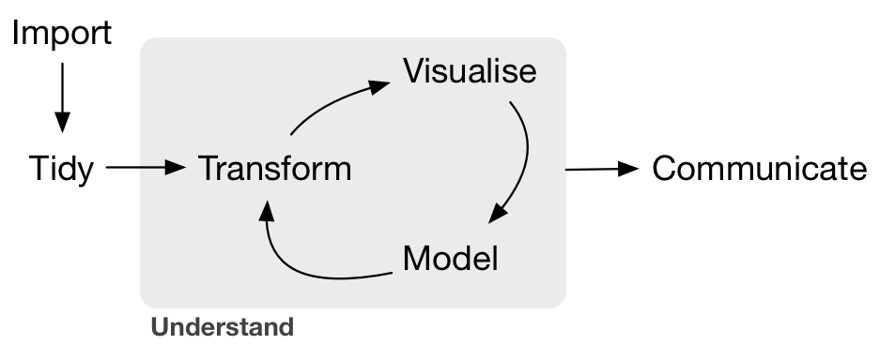
What is Feature Engineering?
[1]
Source: Garrett Grolemund and Hadley Wickham, R for Data Science, https://r4ds.had.co.nz/
[1] https://vita.had.co.nz/papers/tidy-data.html
Notes:
Feature engineering involves transforming the raw data into something that better represents the learning problem to the predictive model, resulting in improved generalization of unseen data.
Feature engineering is key to iteratively building a better model

Slide 18
What is Feature Engineering?
Feature engineering is the process of transforming raw data into something that better represents the learning problem to the predictive model, resulting in improved generalization to unseen data.
“... some machine learning projects succeed and some fail. What makes the difference? Easily the most important factor is the features used.” [Pedro Domingos]
Notes:
“Often the raw data is not amenable to learning, but you can construct features that are”

Slide 19
What do we mean by features?
A feature is an individual measurable property or characteristic of a phenomenon being observed.
Training data {(x_{i}, y_{i})}_{N}
Features Φ(x_{i})
Model f( Φ(x_{i}), θ)
Learning problem argmin_{θ} L( y_{i}, f( Φ(x_{i}), θ) )

Slide 20
What is Feature Engineering?
Encoding prior knowledge we have about the data domain and the problem
Guiding questions
Which information can be ignored?
Which information should be retained?
How should retained information be represented?
Answers to these questions depend on
Data domain
Problem to be solved
Predictive model
Some feature engineering methods are specific to the data and problem domains.
But there are common techniques!

Slide 21
Why don’t we just keep everything?
High-dimensional spaces are challenging to work with.
Curse of Dimensionality
A fixed number of datapoints occupy a fraction of the space that decreases exponentially with the number of dimensions.
The portion of a volume near the surface increases in the number of dimensions.
Distances between points become increasingly indistinguishable
Notes:
Most of the mass of a Multi-variate Gaussian in high-dimensional space is not near the mean but near its shell
Most of the volume of an Orange in high dimension is in the skin, not the pulp
A fixed number of points uniformly distributed are increasinly close to a face of the cube and further away from each other

Slide 22
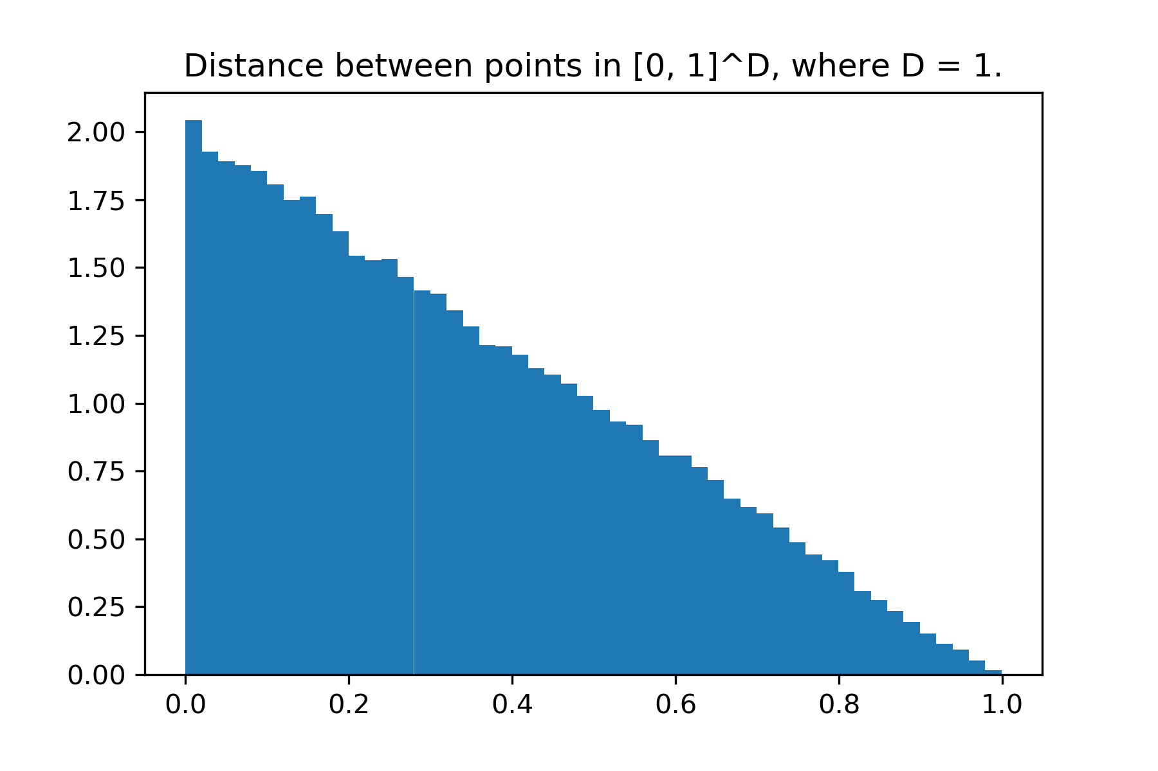
density
distance
Notes:
Consider a random sample of points distributed uniformly in the interval [0, 1]^D in D dimensional space.
How are differences between pairs of points distributed?

Slide 23
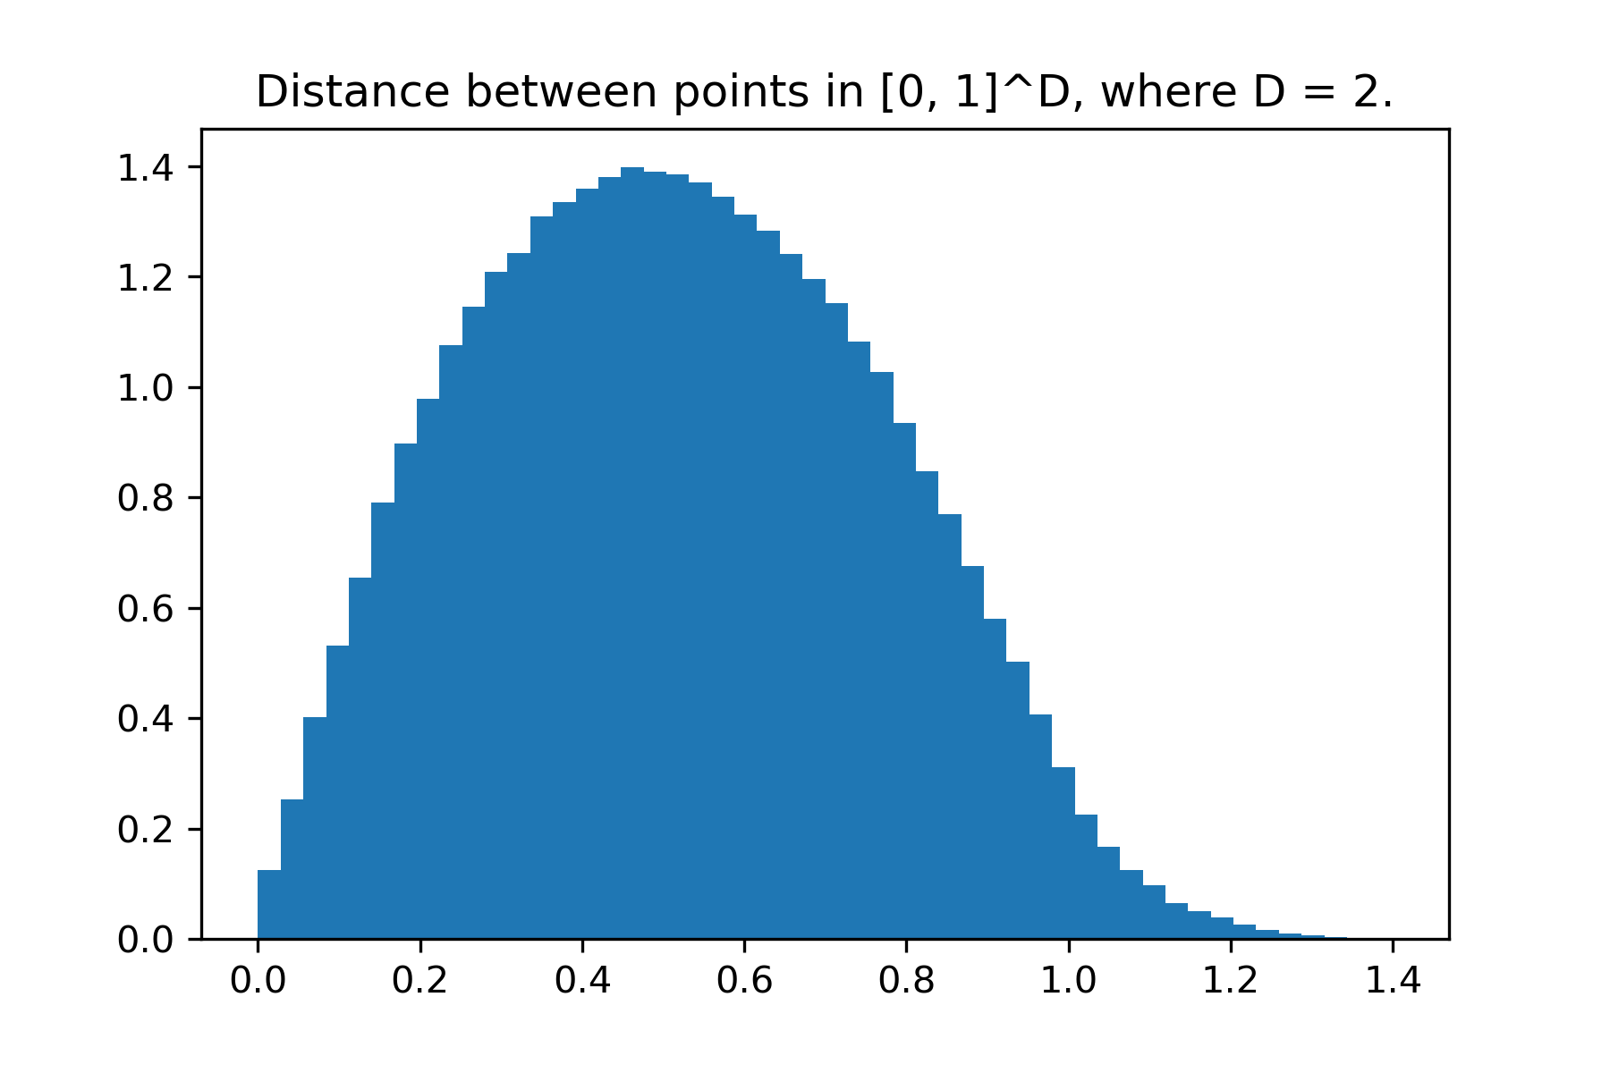
density
distance

Slide 24
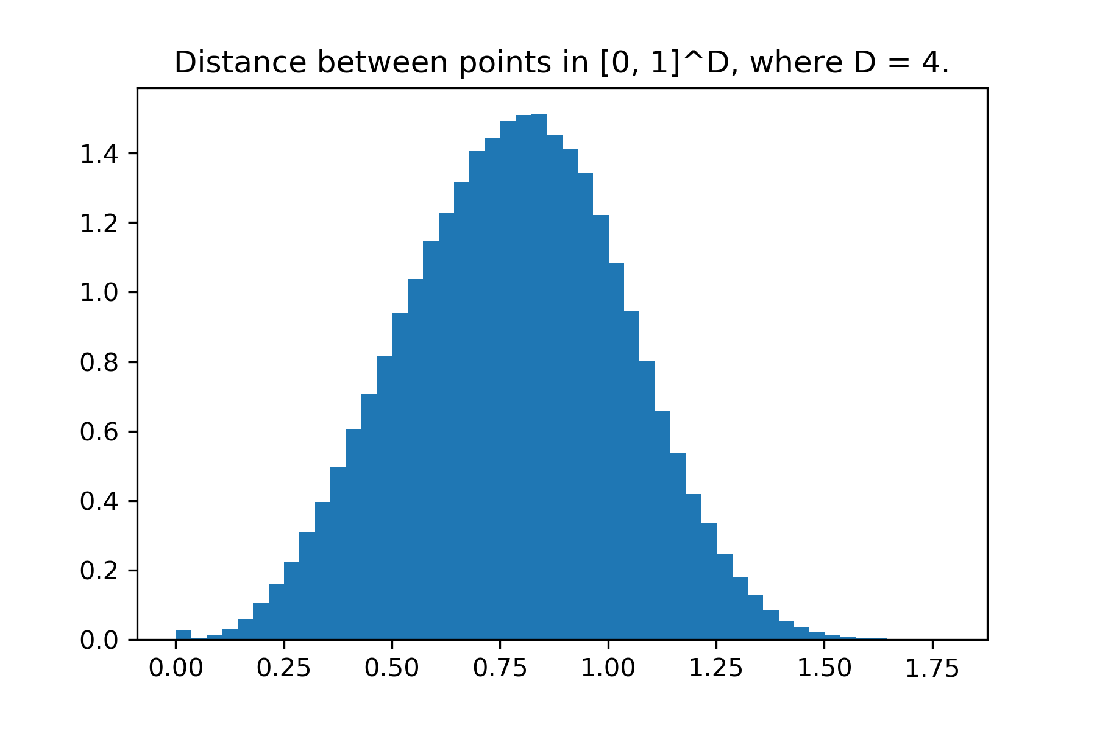
density
distance

Slide 25
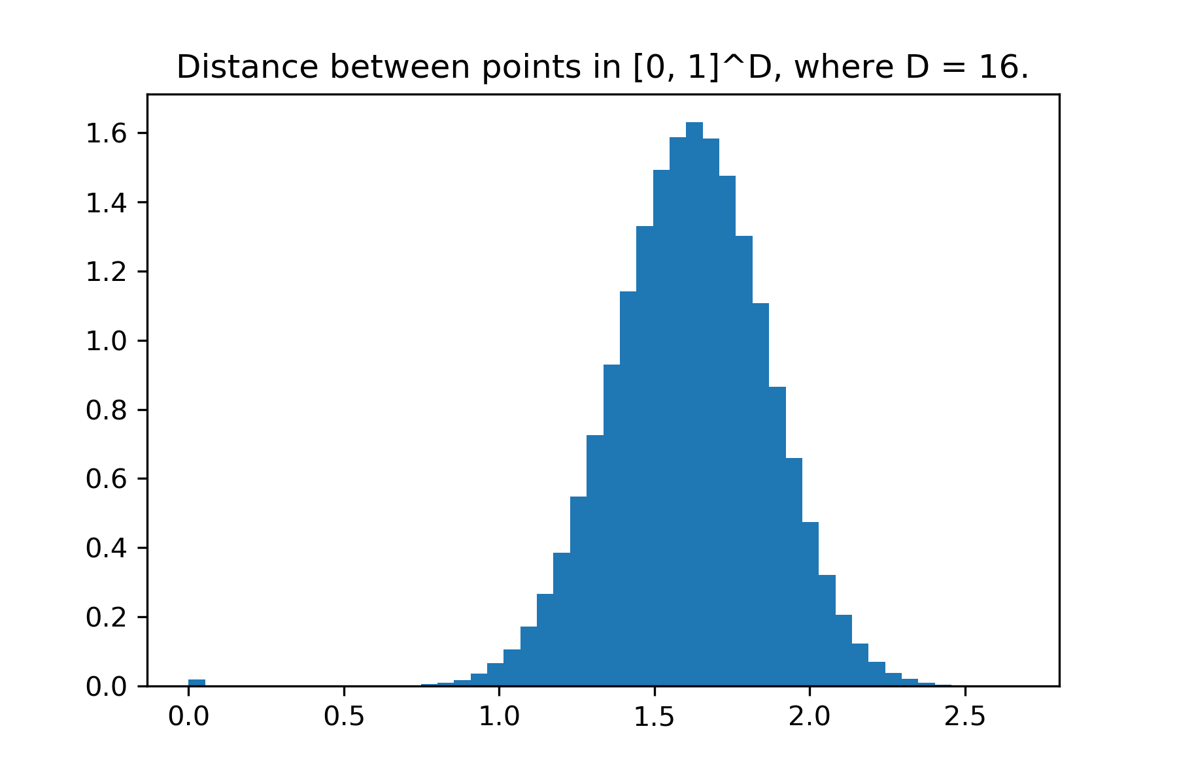
density
distance

Slide 26
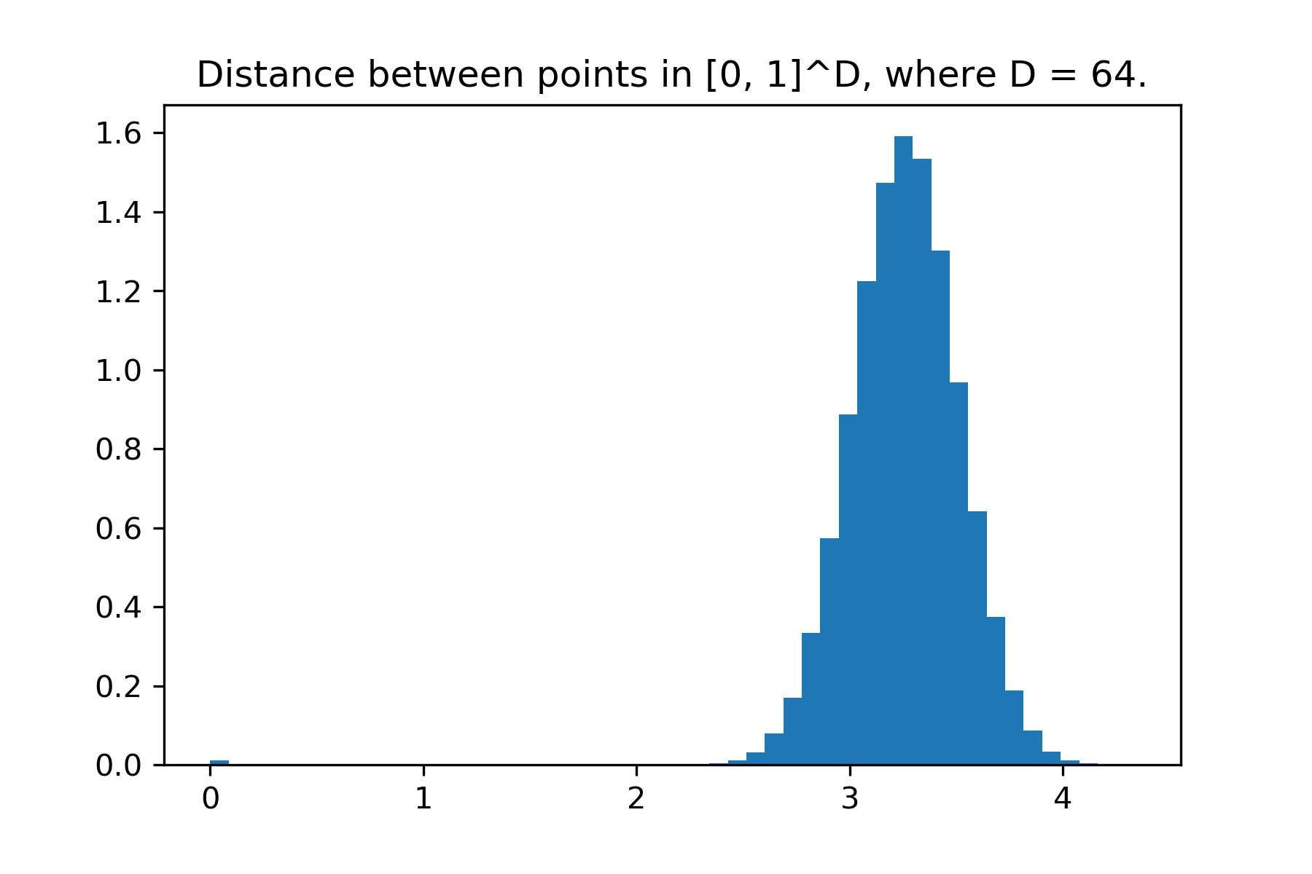
density
distance

Slide 27
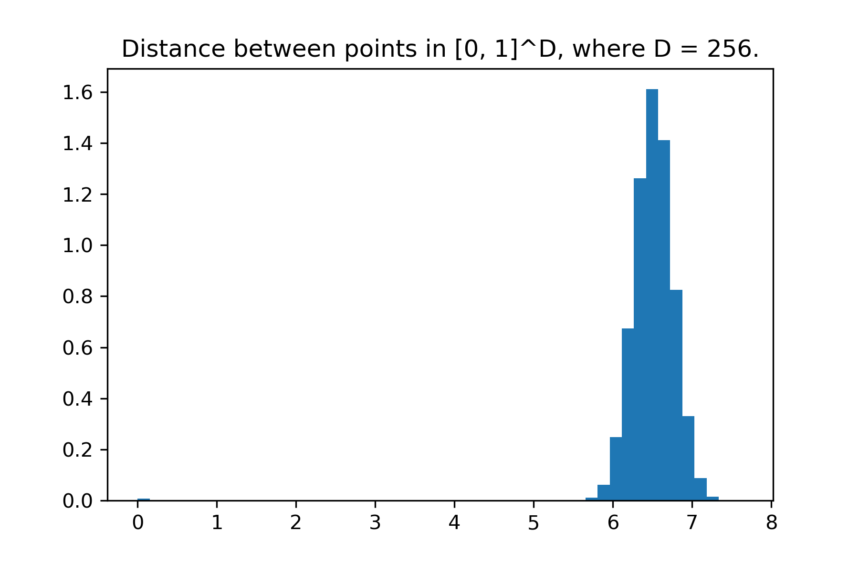
density
distance

Slide 28
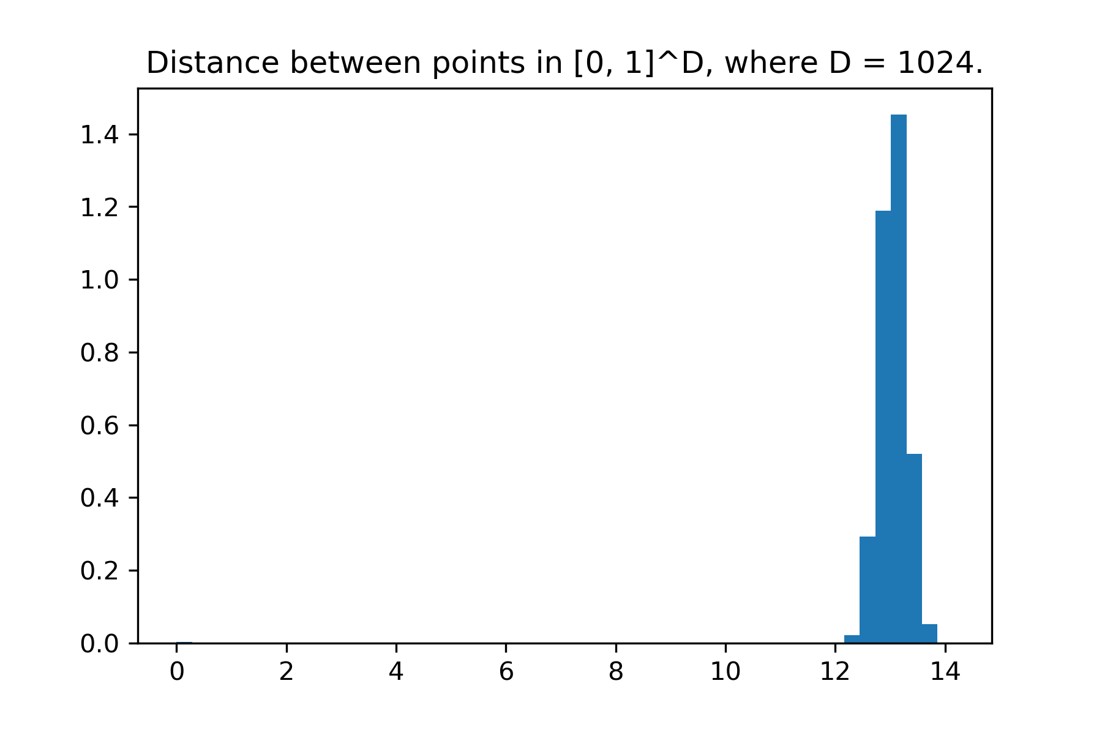
density
distance

Slide 29
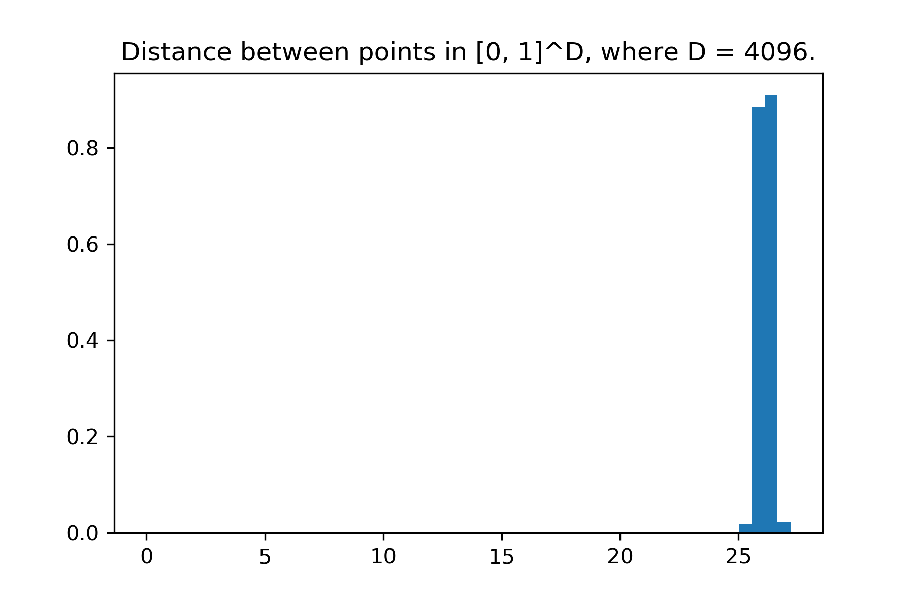
density
distance

Slide 30
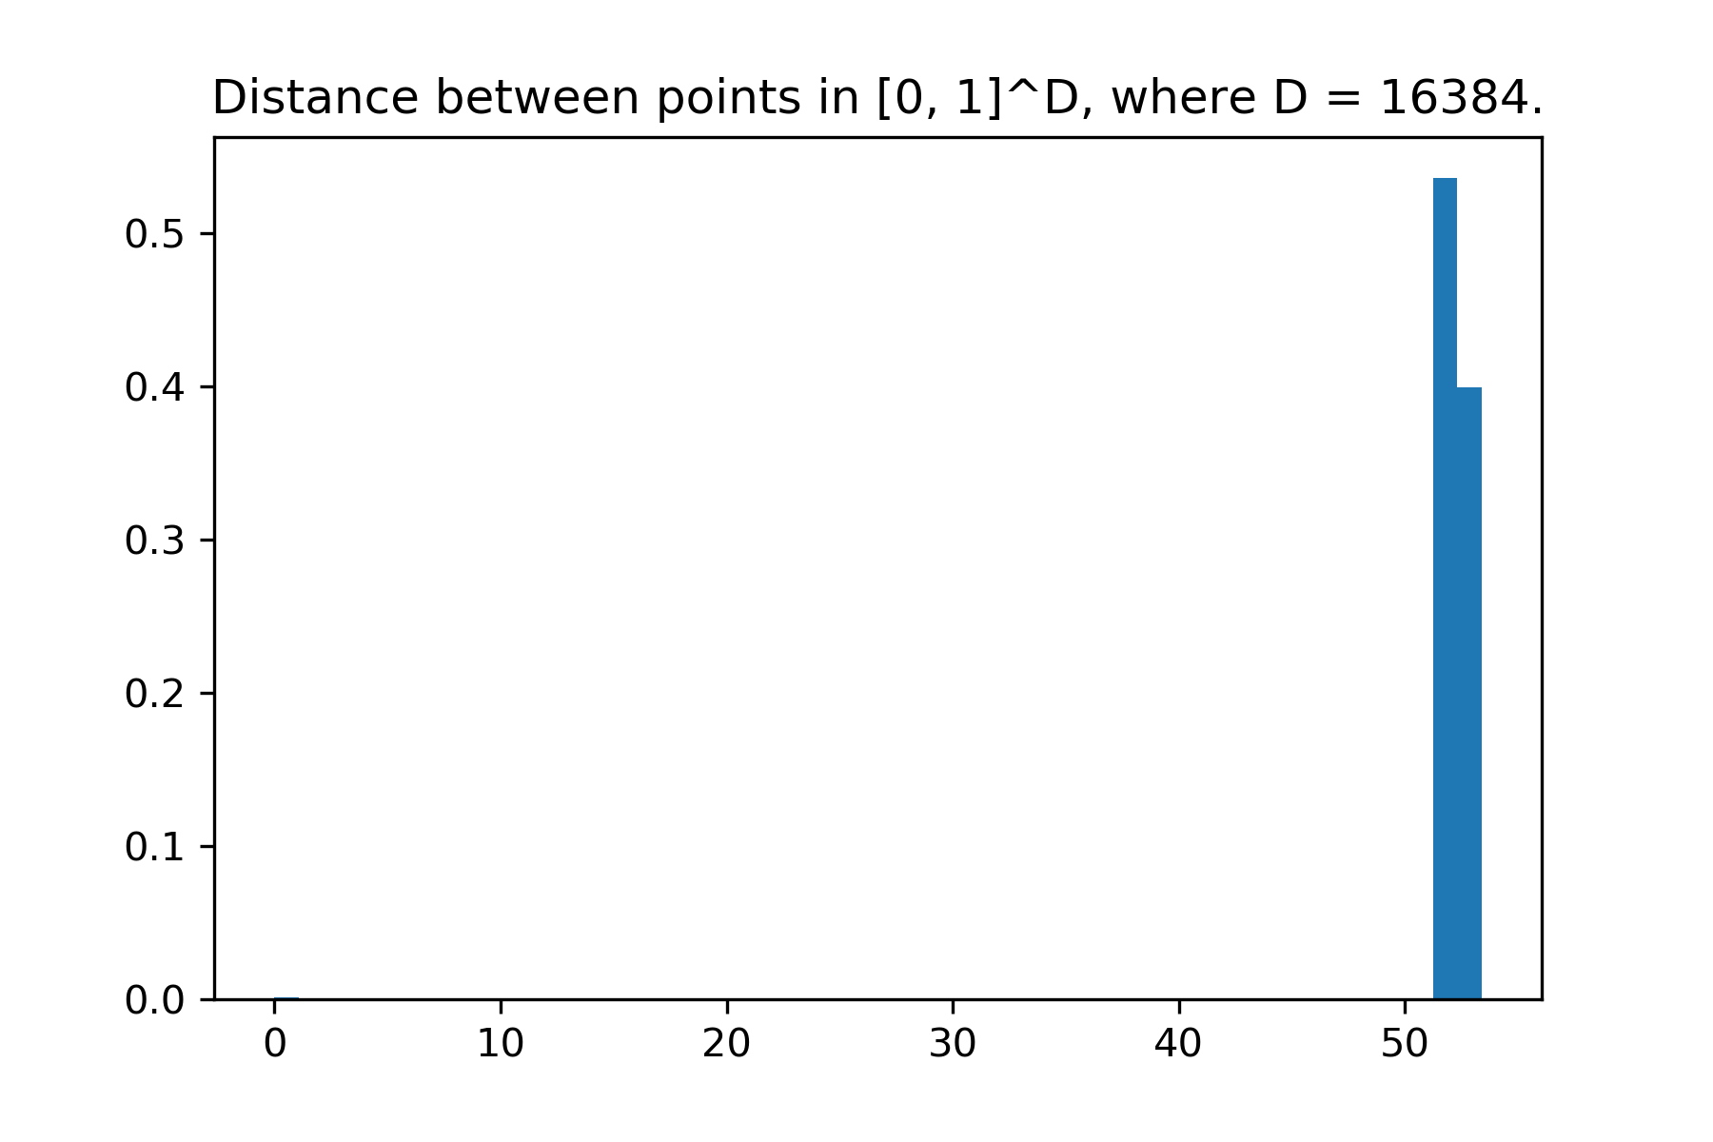
density
distance

Slide 31
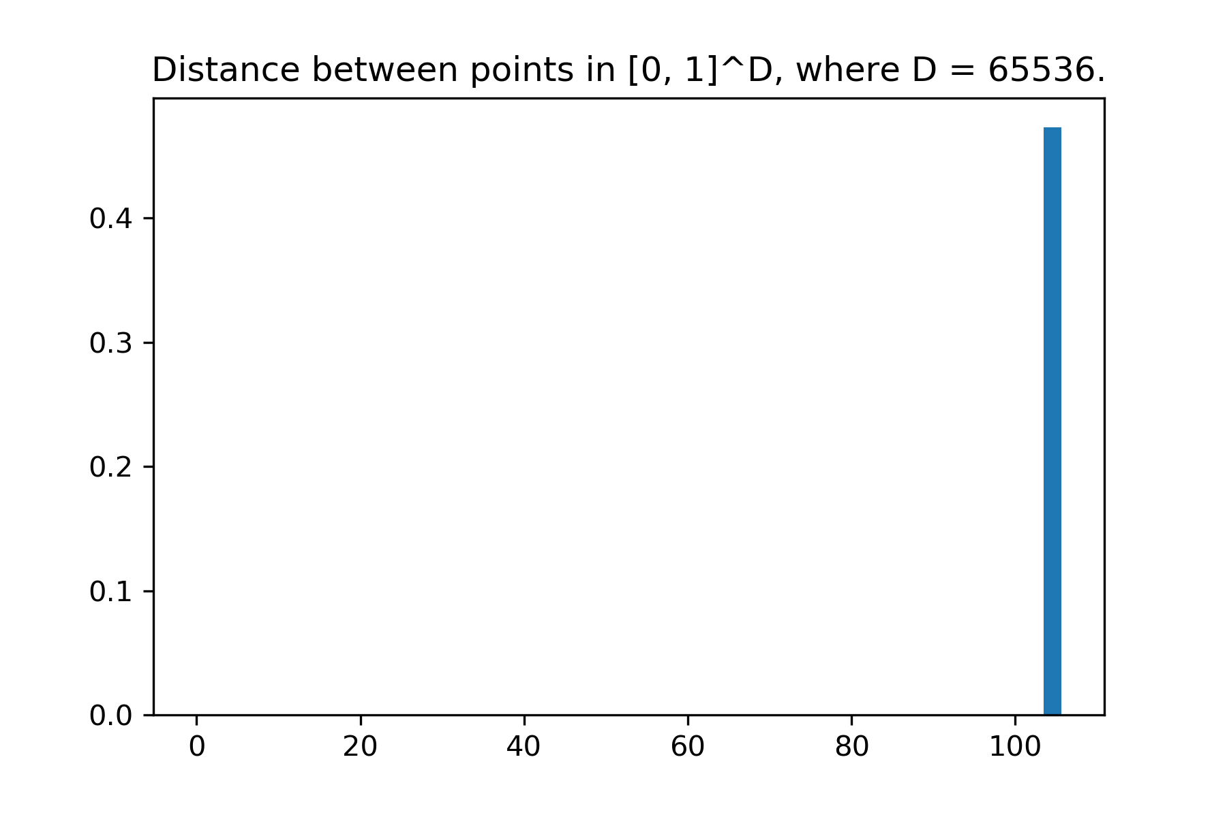
density
distance

Slide 32
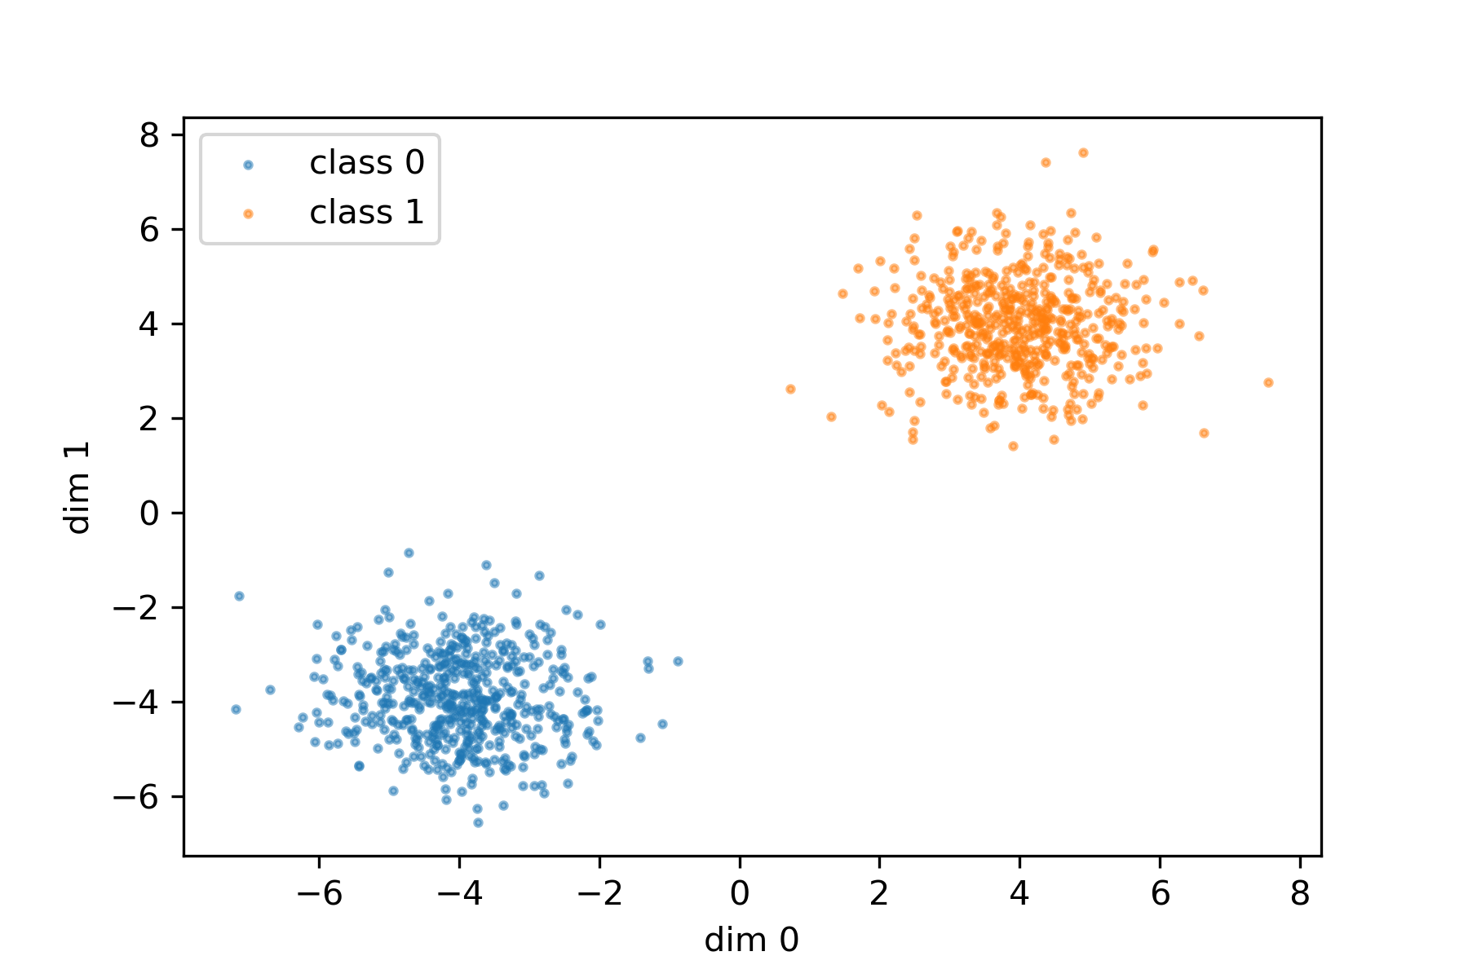
Distractors
Notes:
Consider a two class problems where classes are clearly linearly separable in 2D.
What happens if we add dimensions that contain random noise?

Slide 33
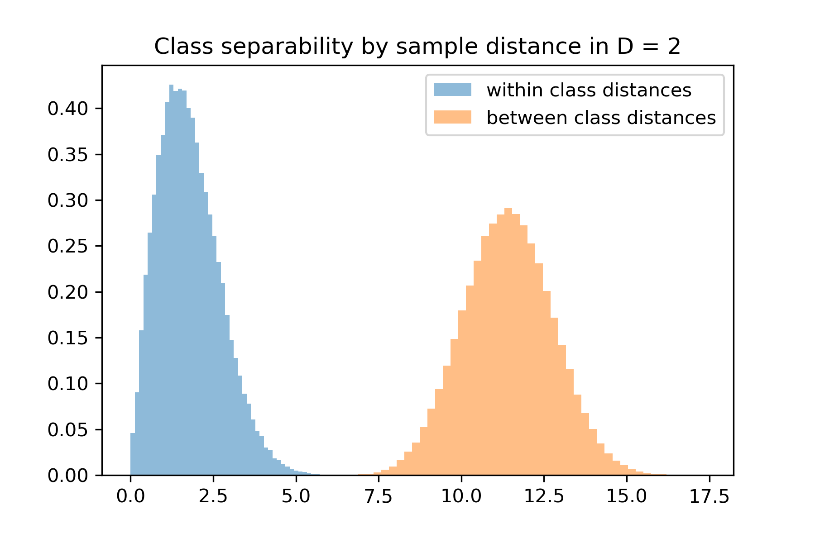
Distractors
distance
Notes:
Consider a two class problems where classes are clearly linearly separable in 2D.
What happens if we add dimensions that contain random noise?

Slide 34
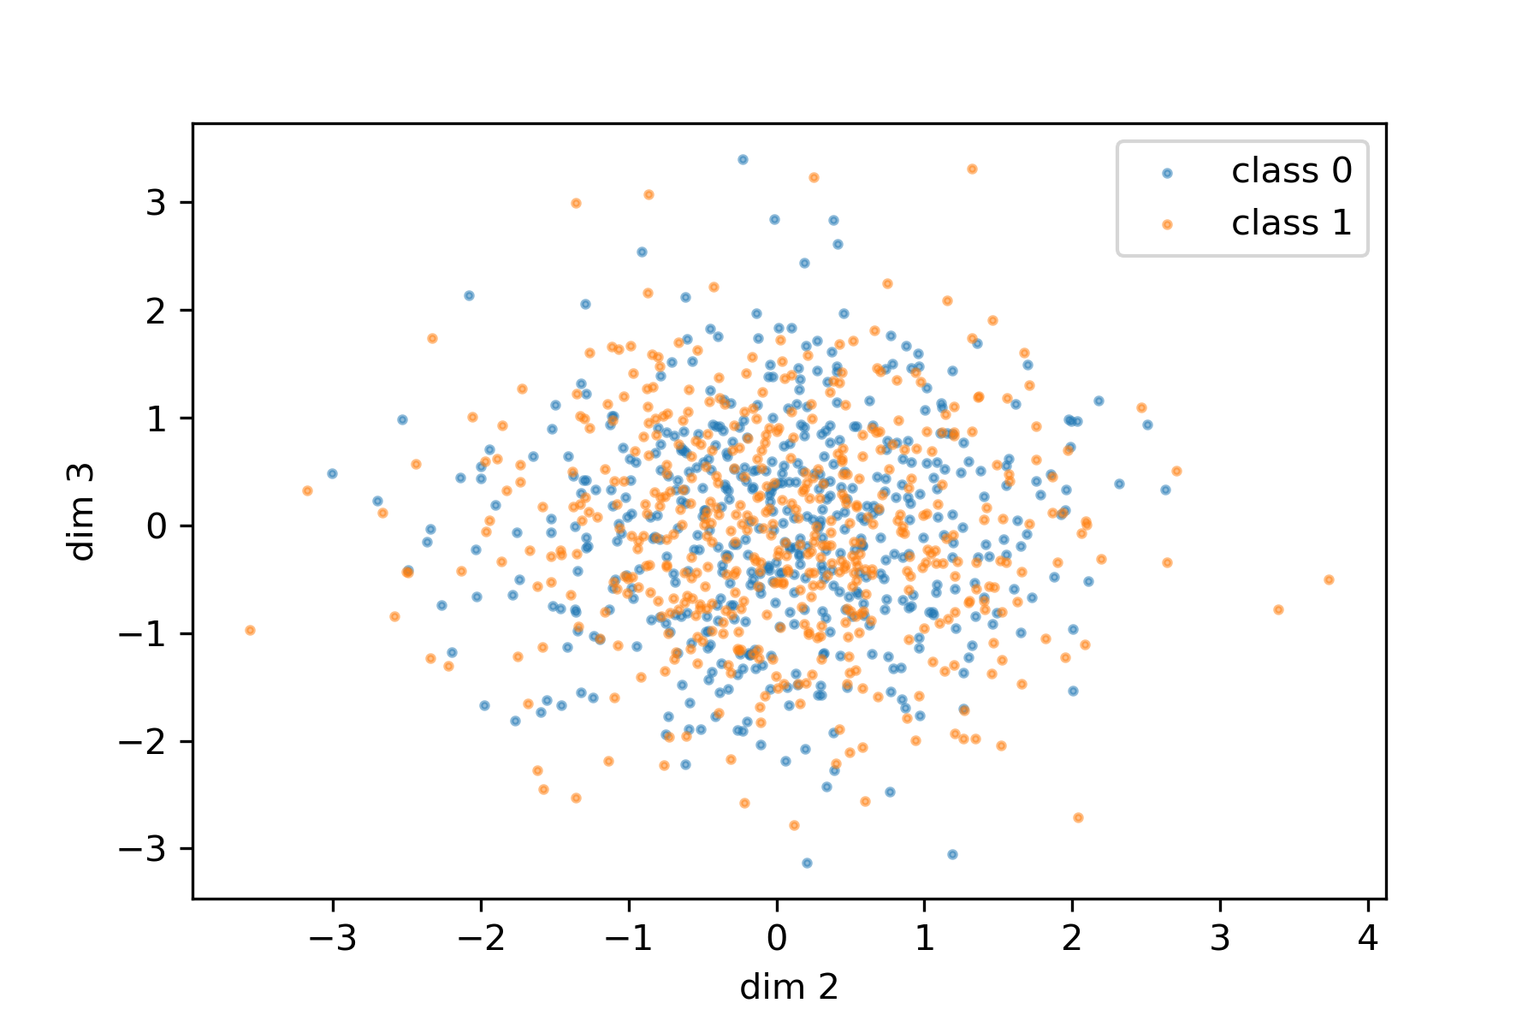
Distractors
Notes:
Consider a two class problems where classes are clearly linearly separable in 2D.
What happens if we add dimensions that contain random noise?

Slide 35
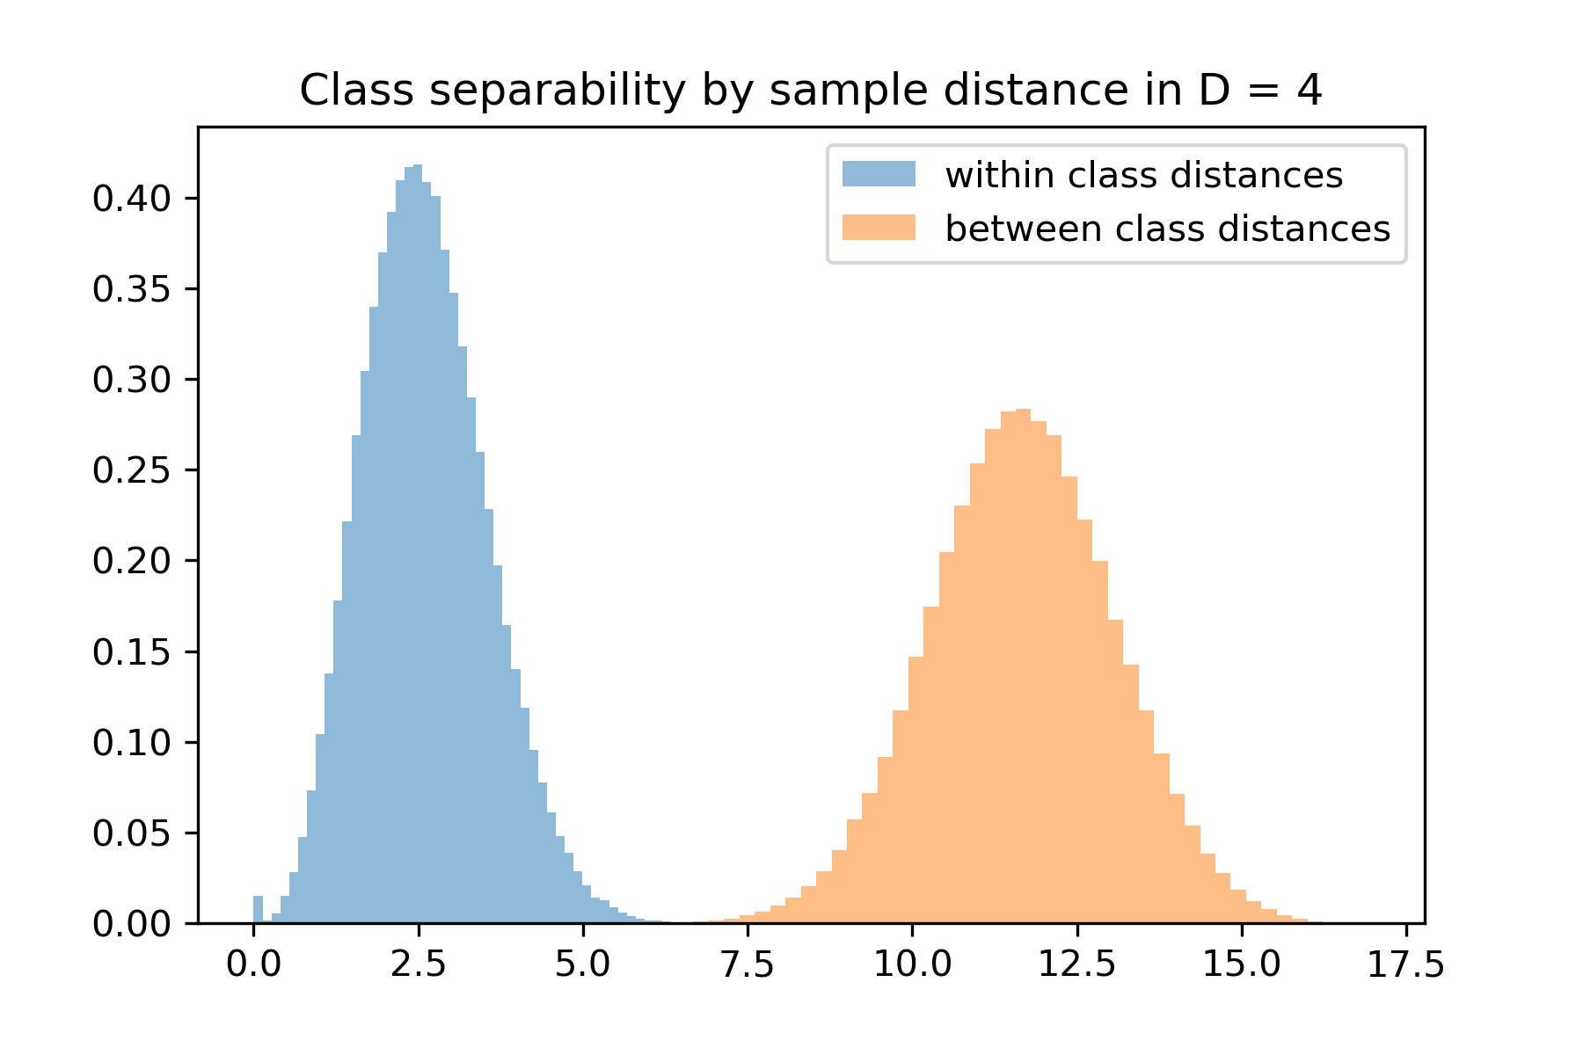
density
distance

Slide 36
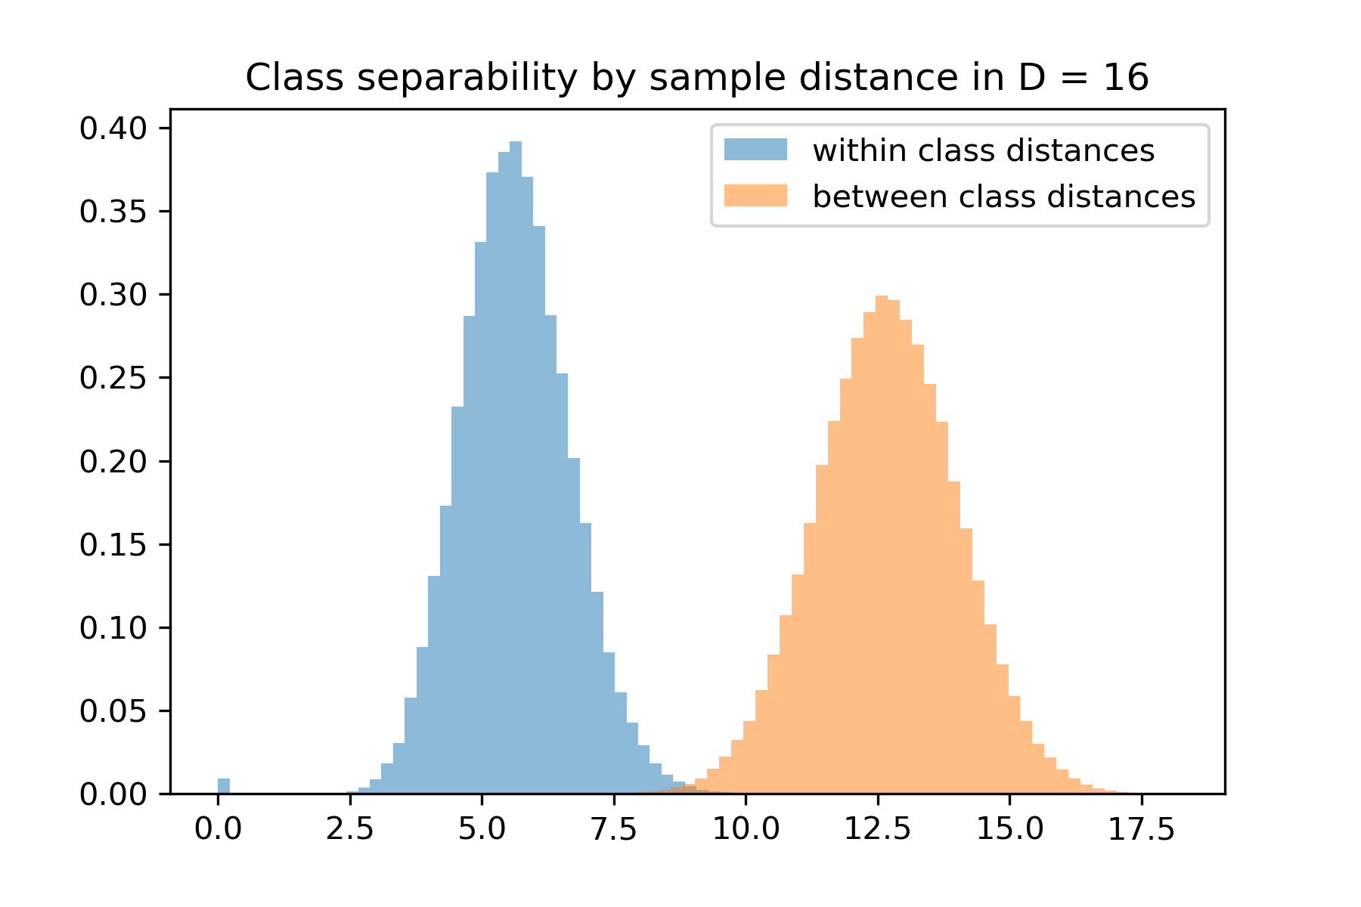
density
distance

Slide 37
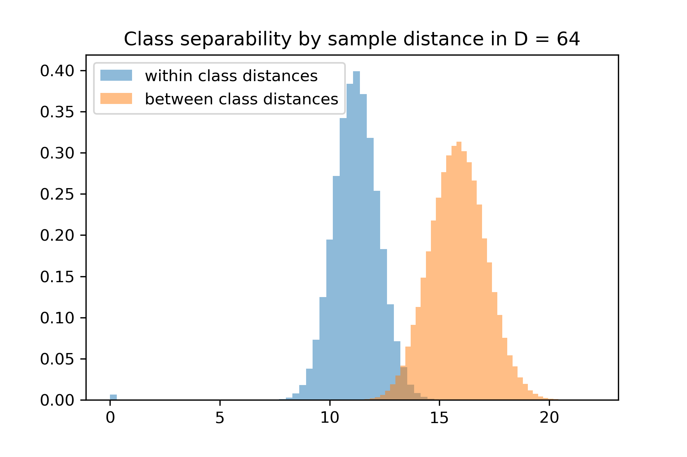
density
distance

Slide 38
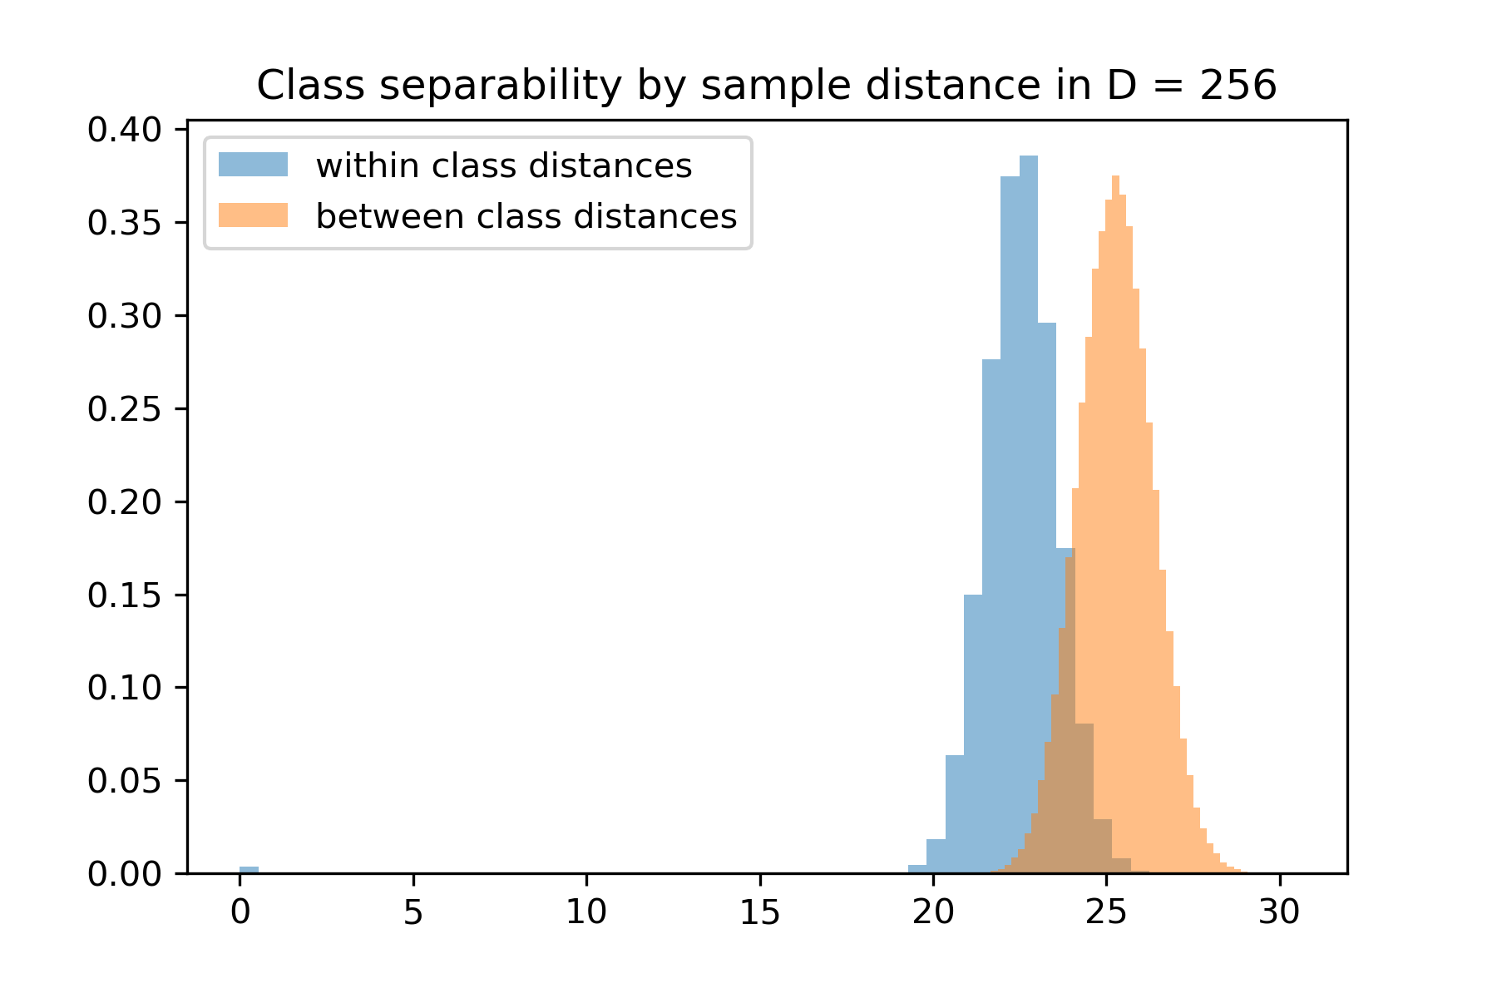
density
distance

Slide 39
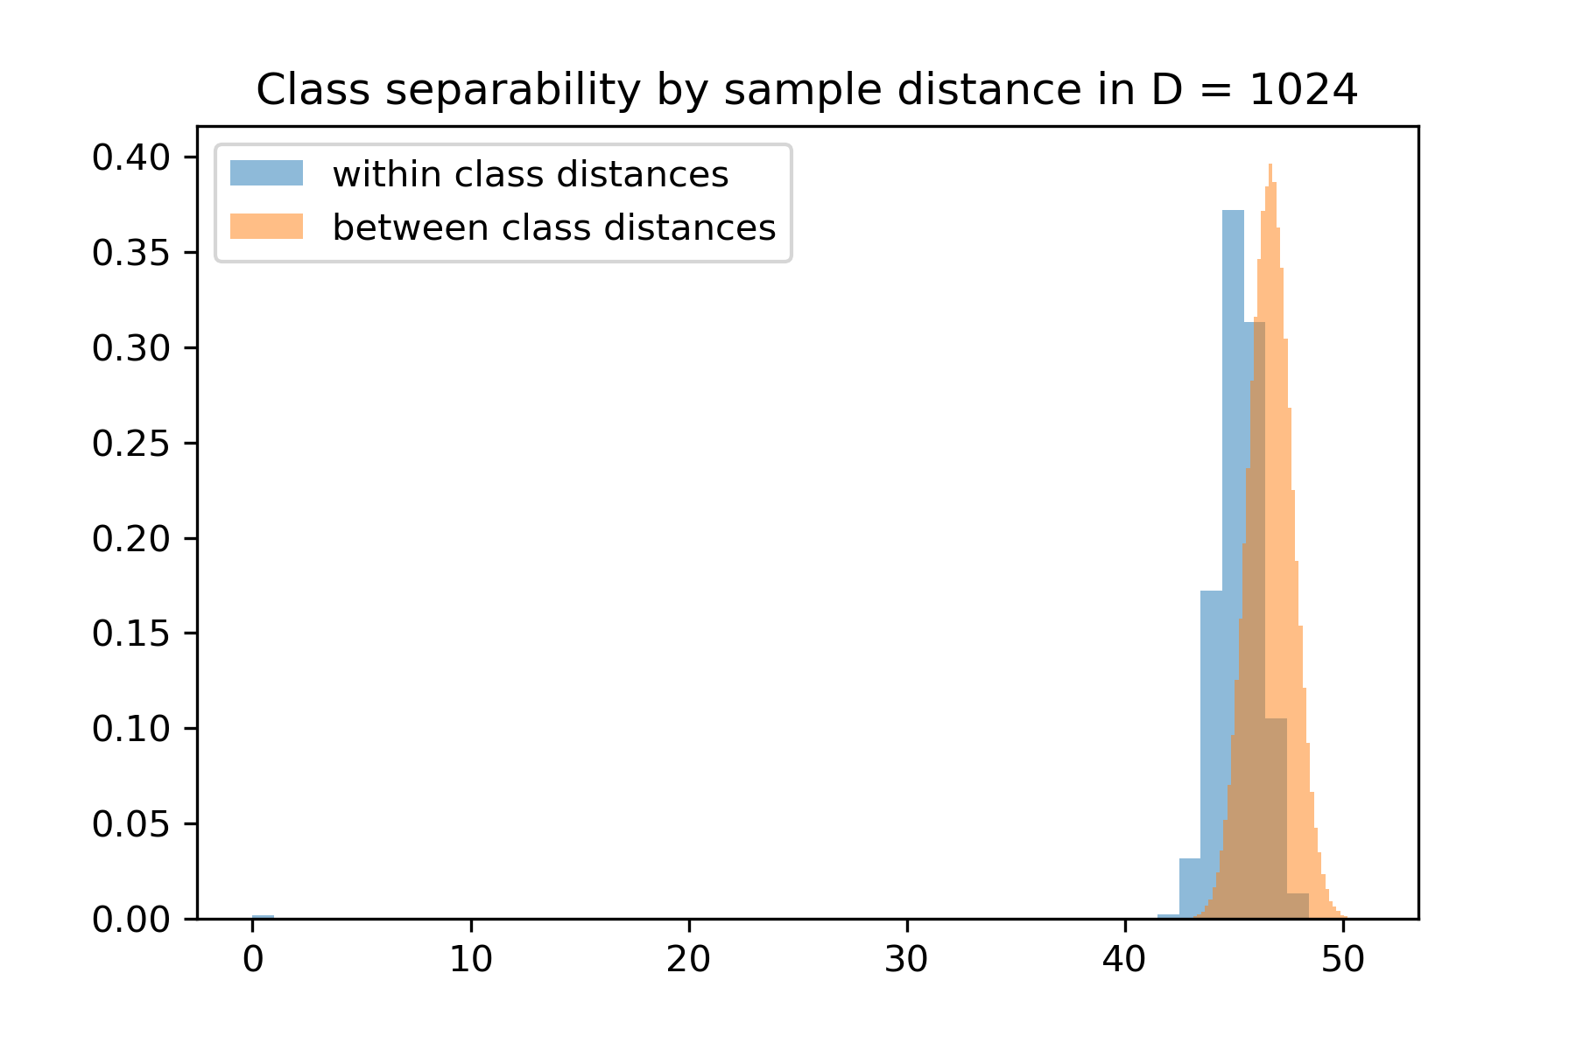
density
distance

Slide 40
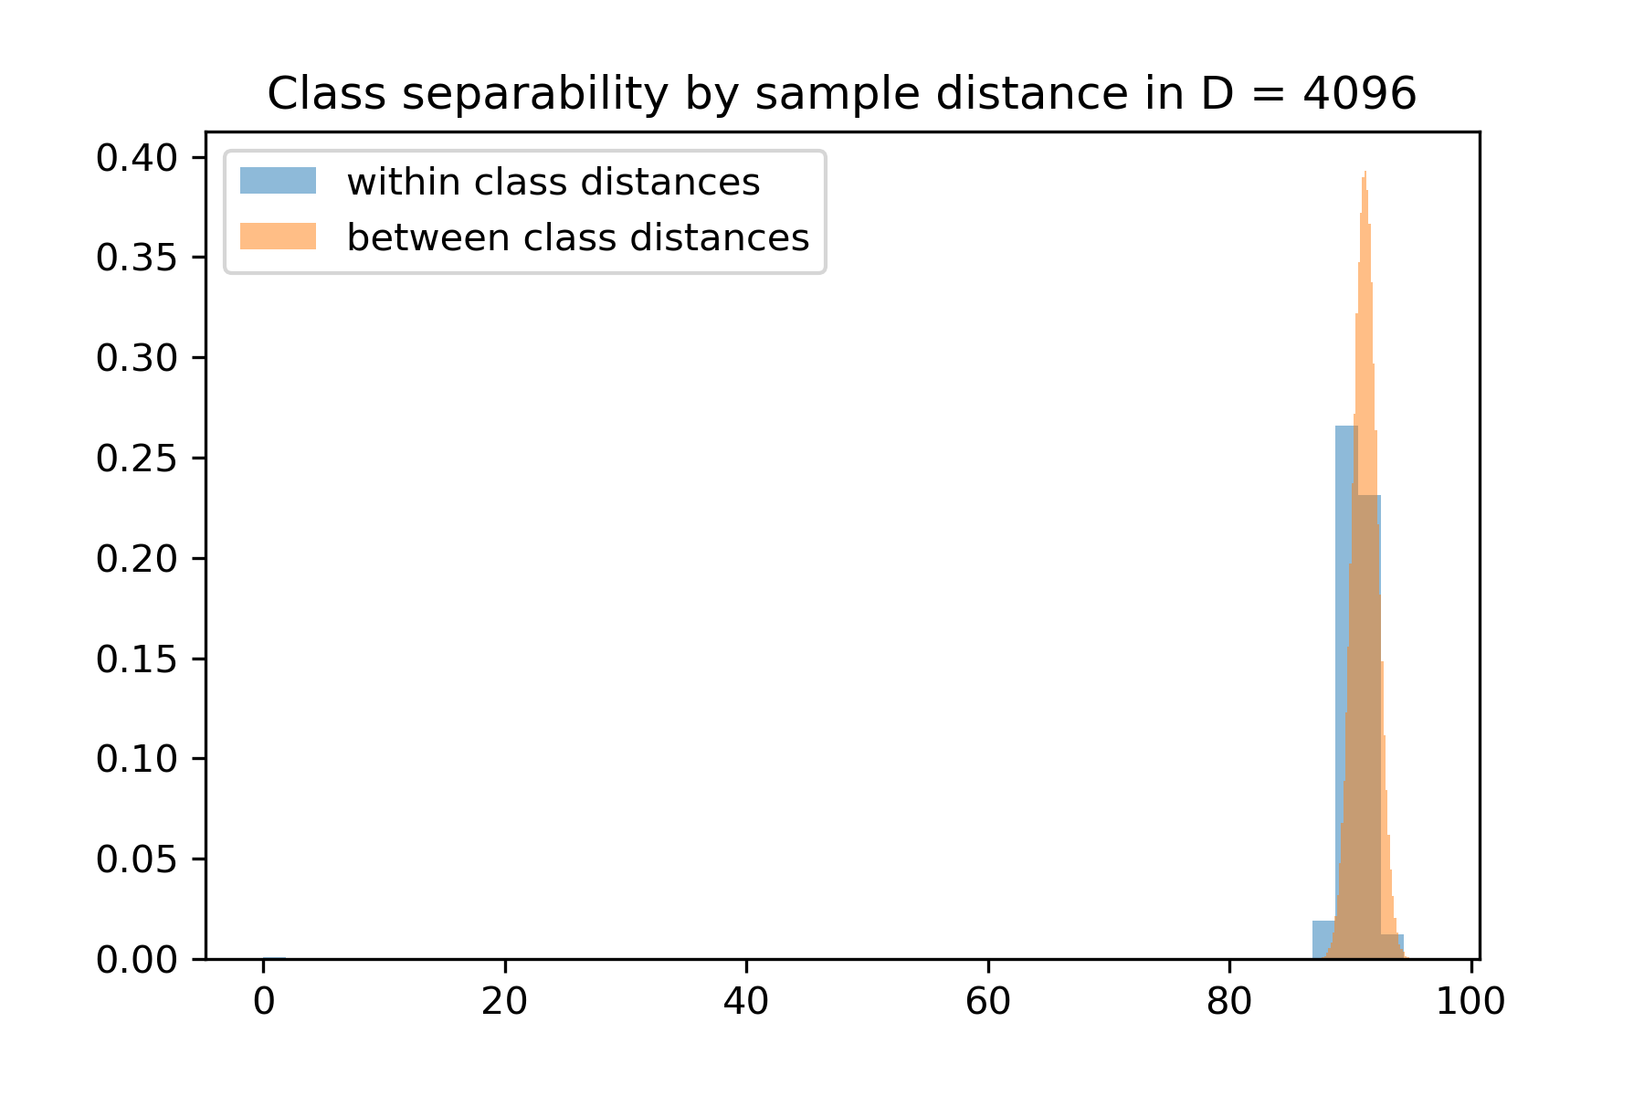
density
distance

Slide 41
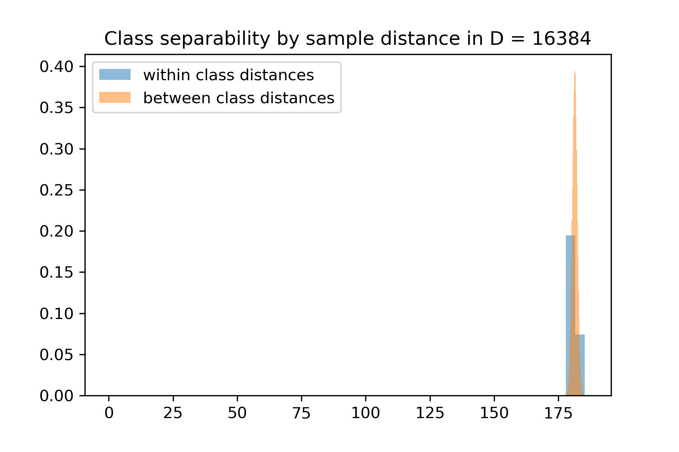
density
distance

Slide 42
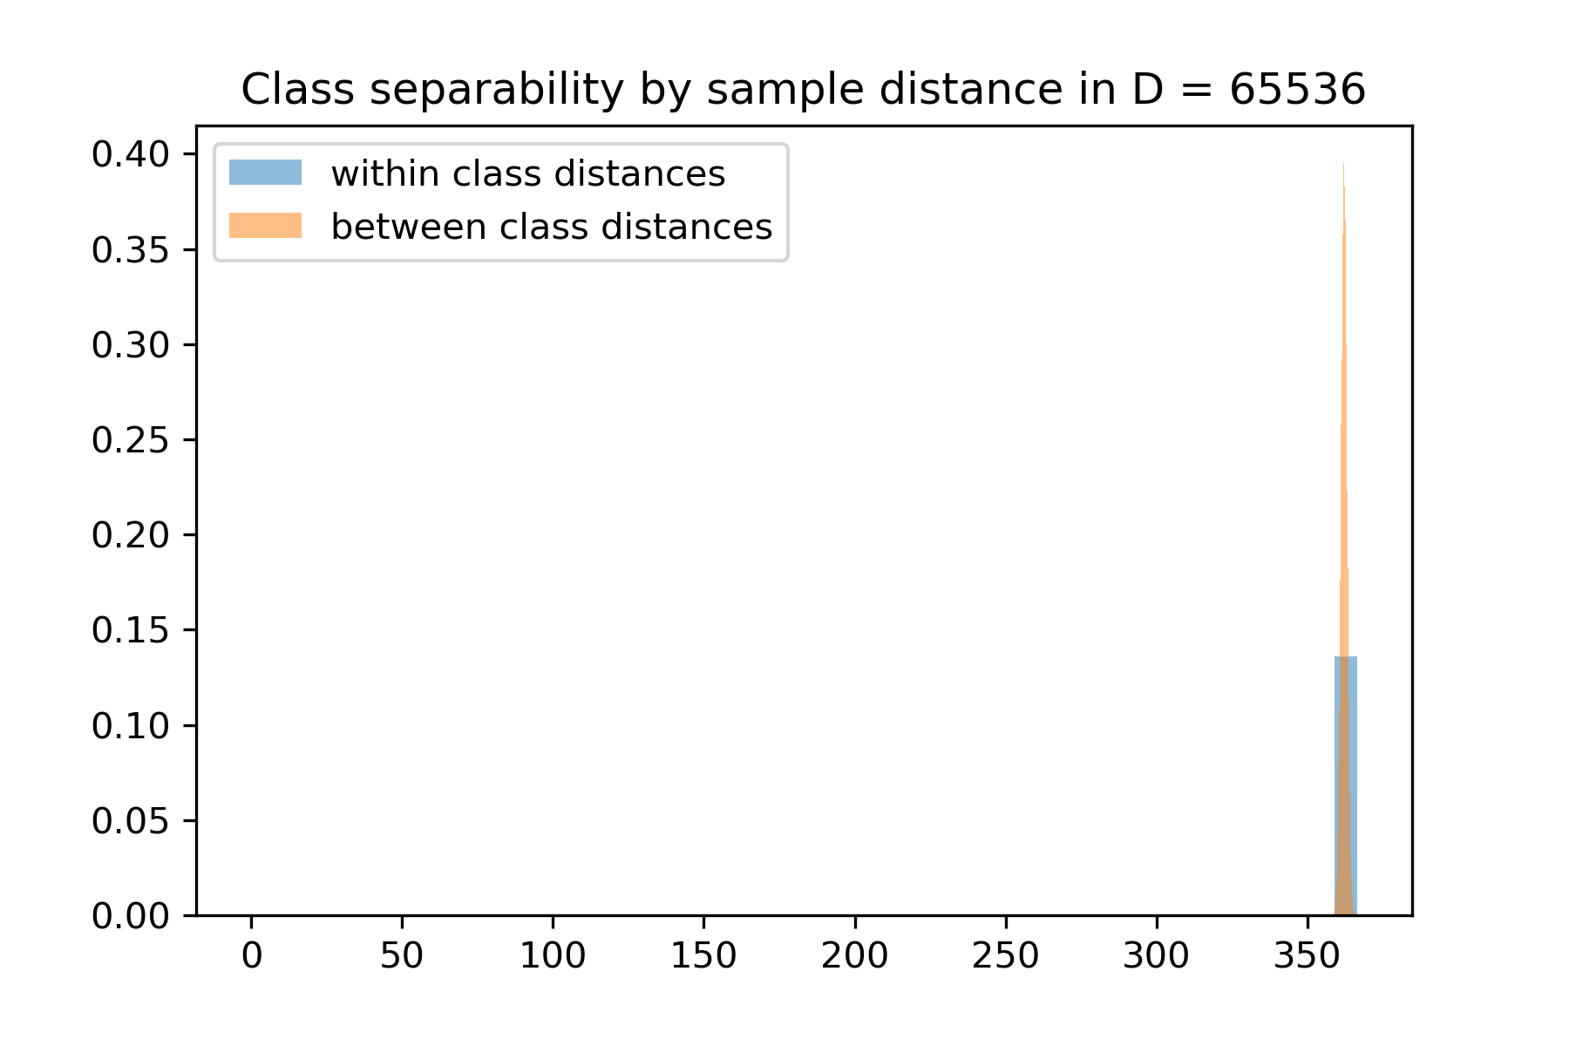
density
distance

Slide 43
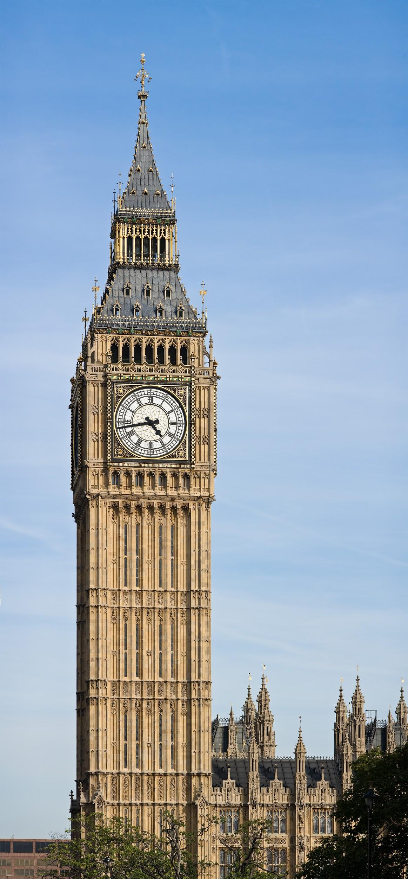
Which features are useful?
what time is it?
Notes:
Imagine we had a dataset of clock-face images and we wanted to train a predictive model that can take in such an image and estimate the time the clock in the image shows.
If this clock was a 100x100 pixel color image, then we could concatenate the three color channels of all pixels into one long feature vector with 30k dimensions.
Training a predictive model on that data will most likely require a ridiculous amount of training data to generalize well. How many dimensions do we really need?

Slide 44
Which features are useful?
What time is it?
Hour hand is sufficient to tell time
Notes:
All information about our problem is contained in the orientation of the hour hand

Slide 45
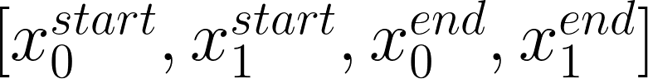
Which features are useful?
What time is it?
Hour hand is sufficient to tell time
Assume we had an hour hand detector
What qualities does a good representation have?
Geometry of the problem
Translation invariance
Scale invariance
Orientation invariance
x₁
x^{start}
x^{end}
x₀

Slide 46
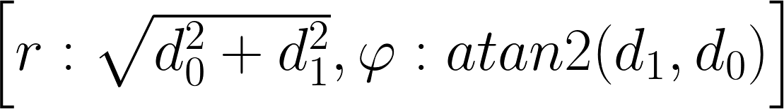

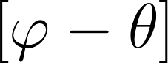
Which features are useful?
What time is it?
Hour hand is sufficient to tell time
Assume we had an hour hand detector
Polar coordinate representation
Scale invariance
Orientation Invariance, assuming some reference angle
x₁
x^{start}
x^{end}
x₀

Slide 47
Are the same features useful for different tasks?
Is this a clock or pressure gauge?

Slide 48
Which features are useful?
What year was the clock built?

Slide 49
Which features are useful?
How will this image look 5 minutes later?

Slide 50
Which features are useful?
How does the
surrounding context
look?

Slide 51
Overview
Case Study 1
What is Feature Engineering?
Feature Selection: Finding Relevant Subsets of Features
Filtering Methods
Wrapper Methods
Embedding Methods
Feature Extraction
Notes:
Finding Relevant Subsets of Features

Slide 52
Feature Selection
Context
Dataset with D features per datapoint.
Goal
Find the subspace of M << D features with minimal error on hold-out set.
Brute-force subset evaluation is exponential in the number of features (NP-hard problem)
Heuristics
Filtering: use surrogate measure and test individual features’ relevance
Wrappers: greedily build feature set and evaluation using predictive model
Embedding: predictive model selects features during learning process (e.g., LASSO)
Notes:
Selection: discarding a subset of input dimensions (e.g., to identify influential feature subsets)
Filter (relevance test based on data only; mostly univariate tests + ranking)
Features that look irrelevant in isolation may be relevant in combination (XOR)
Wrapper (feature selection as search problem in conjunction with clasifier performance testing)
Embedding (feature selection part of training process, e.g. L1 regularization)

Slide 53
Filtering Methods
Idea:
Measure relevance of individual feature for dependent variable.
Rank features by relevance
Keep top K relevant features; k could be chosen via cross-validation
Statistical tests used as relevance scores:
Pearson Correlation
Chi-Square
Mutual Information
t-test / ANOVA
Notes:
Further reading
https://www.sagepub.com/sites/default/files/upm-binaries/33663_Chapter4.pdf
SKLearn
https://scikit-learn.org/stable/modules/feature_selection.html

Slide 54
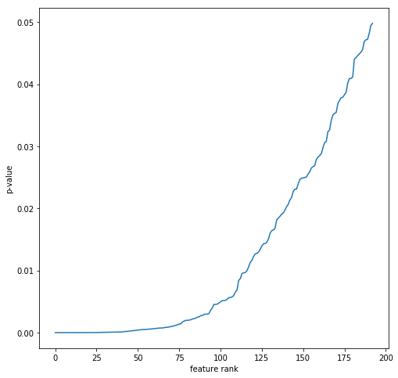
Filtering: Case Study 1
Notes:
P-values from F-test using sklearn f_classif, applied to all 432 features

Slide 55
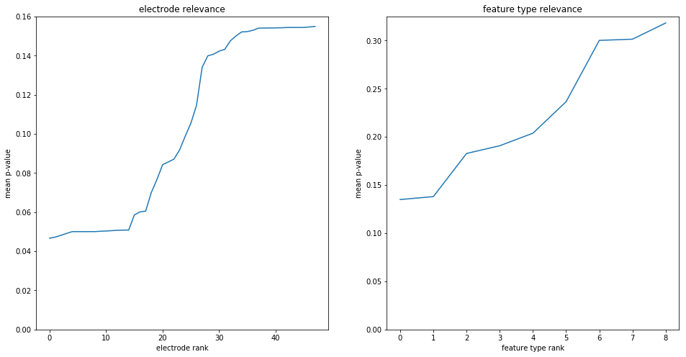
Filtering: Case Study 1
Notes:
Aggregated relevance per electrode (mean across features) and per feature (mean across electrodes)

Slide 56
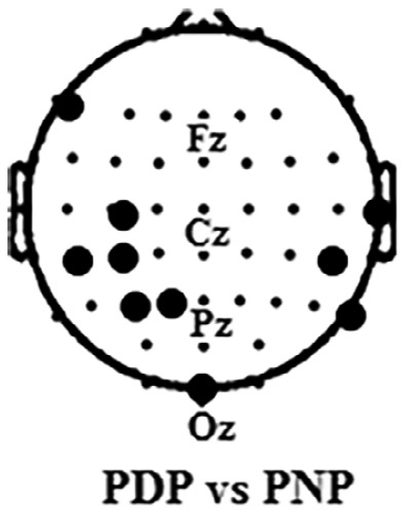
Filtering: Case Study 1
Notes:
An example outcome could be using a subset of features from a subset of electrodes, for example.

Slide 57
Wrapper Methods
Backward feature elimination
Initialize the feature set F to include all features F₀: {f₀, f₁, …, , f_{M-1}} and evaluate performance
Evaluate performance with feature sets F\f_{i} , removing a single feature f_{i} from F.
Update F to exclude f_{i} for the one feature that maximally maintained or increased performance.
Repeat steps 2 and 3 until
Performance degrades
Target number of features is reached

Slide 58
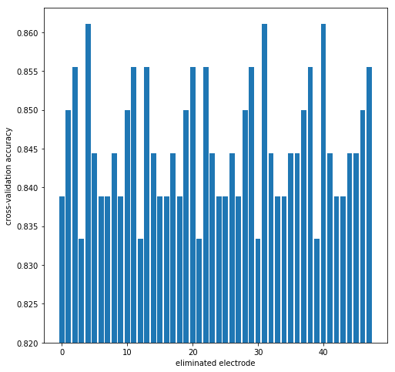
Backward Electrode Elimination: Case Study 1
Iteration 1
baseline performance
Notes:
Simple Logistic Regression without optimized parameters using sklearn
https://scikit-learn.org/stable/modules/generated/sklearn.linear_model.LogisticRegression.html

Slide 59
Backward Electrode Elimination: Case Study 1
Iteration 1
Removing any of these electrodes improves performance
baseline performance
Notes:
Simple Logistic Regression without optimized parameters using sklearn
https://scikit-learn.org/stable/modules/generated/sklearn.linear_model.LogisticRegression.html

Slide 60
Backward Electrode Elimination: Case Study 1
Iteration 1
Removing electrode 4
baseline performance
Notes:
Simple Logistic Regression without optimized parameters using sklearn
https://scikit-learn.org/stable/modules/generated/sklearn.linear_model.LogisticRegression.html

Slide 61
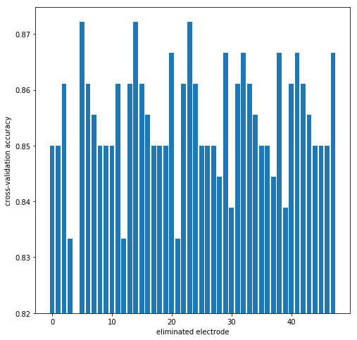
Backward Electrode Elimination: Case Study 1
Iteration 2
new baseline performance
Notes:
Simple Logistic Regression without optimized parameters using sklearn
https://scikit-learn.org/stable/modules/generated/sklearn.linear_model.LogisticRegression.html

Slide 62
Backward Electrode Elimination: Case Study 1
Iteration 2
Removing any of these electrodes improves performance
new baseline performance
Notes:
Simple Logistic Regression without optimized parameters using sklearn
https://scikit-learn.org/stable/modules/generated/sklearn.linear_model.LogisticRegression.html

Slide 63
Backward Electrode Elimination: Case Study 1
Iteration 2
Removing electrode 5
new baseline performance
Notes:
Simple Logistic Regression without optimized parameters using sklearn
https://scikit-learn.org/stable/modules/generated/sklearn.linear_model.LogisticRegression.html

Slide 64
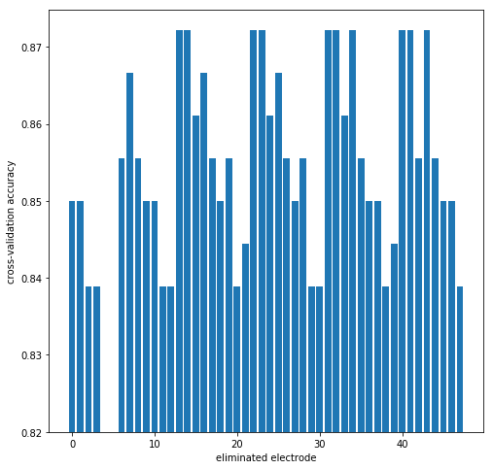
Backward Electrode Elimination: Case Study 1
Iteration 3
new baseline performance
Notes:
Simple Logistic Regression without optimized parameters using sklearn
https://scikit-learn.org/stable/modules/generated/sklearn.linear_model.LogisticRegression.html

Slide 65
Backward Electrode Elimination: Case Study 1
Iteration 3
Removing any of these electrodes does not degrade performance.
new baseline performance
Notes:
Simple Logistic Regression without optimized parameters using sklearn
https://scikit-learn.org/stable/modules/generated/sklearn.linear_model.LogisticRegression.html

Slide 66
Backward Electrode Elimination: Case Study 1
Iteration 3
Removing electrode 13
new baseline performance
Notes:
Simple Logistic Regression without optimized parameters using sklearn
https://scikit-learn.org/stable/modules/generated/sklearn.linear_model.LogisticRegression.html

Slide 67
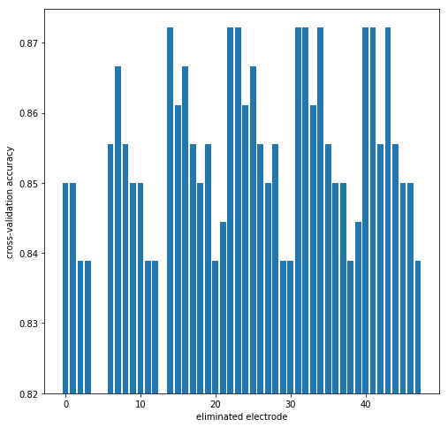
Backward Electrode Elimination: Case Study 1
Iteration 4
Removing any of these electrodes does not degrade performance.
unchanged baseline performance
Notes:
Simple Logistic Regression without optimized parameters using sklearn
https://scikit-learn.org/stable/modules/generated/sklearn.linear_model.LogisticRegression.html

Slide 68
Backward Electrode Elimination: Case Study 1
Iteration 4
Removing electrode 14
unchanged baseline performance
Notes:
Simple Logistic Regression without optimized parameters using sklearn
https://scikit-learn.org/stable/modules/generated/sklearn.linear_model.LogisticRegression.html

Slide 69
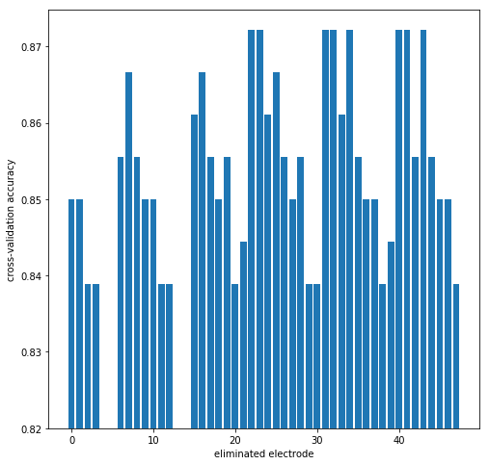
Backward Electrode Elimination: Case Study 1
Iteration 5
Removing electrode 22
unchanged baseline performance
Notes:
Simple Logistic Regression without optimized parameters using sklearn
https://scikit-learn.org/stable/modules/generated/sklearn.linear_model.LogisticRegression.html

Slide 70

Backward Electrode Elimination: Case Study 1
Iteration 6
Removing electrode 23
unchanged baseline performance
Notes:
Simple Logistic Regression without optimized parameters using sklearn
https://scikit-learn.org/stable/modules/generated/sklearn.linear_model.LogisticRegression.html

Slide 71
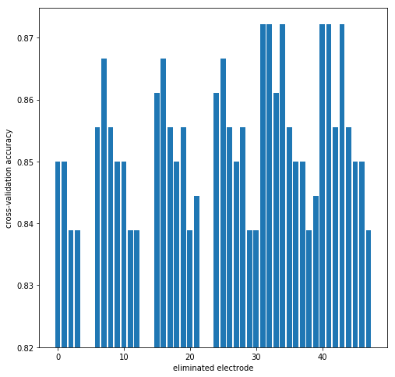
Backward Electrode Elimination: Case Study 1
Iteration 7
Removing electrode 31
unchanged baseline performance
Notes:
Simple Logistic Regression without optimized parameters using sklearn
https://scikit-learn.org/stable/modules/generated/sklearn.linear_model.LogisticRegression.html

Slide 72
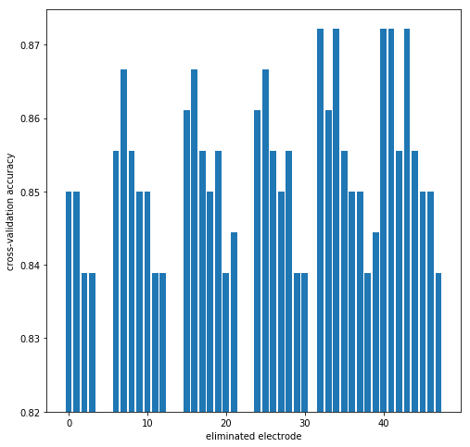
Backward Electrode Elimination: Case Study 1
Iteration 8
Removing electrode 32
unchanged baseline performance
Notes:
Simple Logistic Regression without optimized parameters using sklearn
https://scikit-learn.org/stable/modules/generated/sklearn.linear_model.LogisticRegression.html

Slide 73
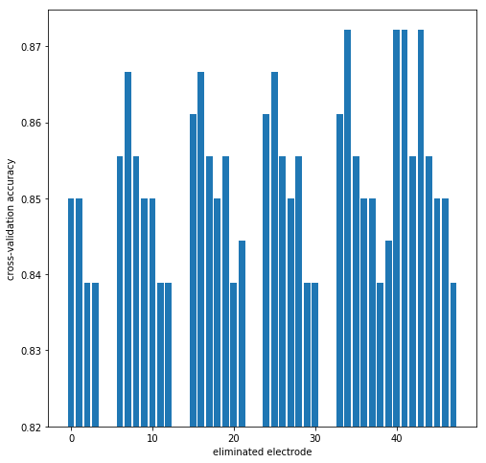
Backward Electrode Elimination: Case Study 1
Iteration 9
Removing electrode 34
unchanged baseline performance
Notes:
Simple Logistic Regression without optimized parameters using sklearn
https://scikit-learn.org/stable/modules/generated/sklearn.linear_model.LogisticRegression.html

Slide 74
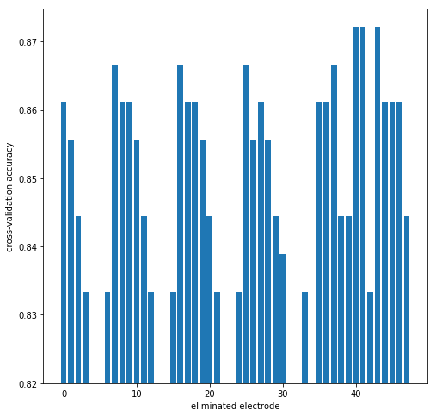
Backward Electrode Elimination: Case Study 1
Iteration 10
Removing electrode 40
unchanged baseline performance
Notes:
Simple Logistic Regression without optimized parameters using sklearn
https://scikit-learn.org/stable/modules/generated/sklearn.linear_model.LogisticRegression.html

Slide 75
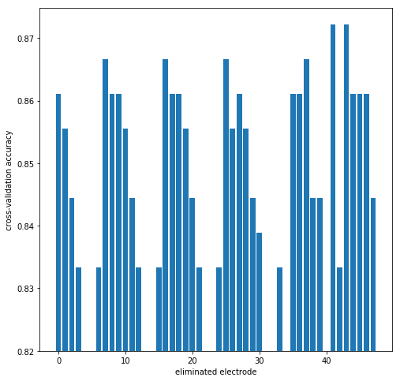
Backward Electrode Elimination: Case Study 1
Iteration 11
Removing electrode 41
unchanged baseline performance
Notes:
Simple Logistic Regression without optimized parameters using sklearn
https://scikit-learn.org/stable/modules/generated/sklearn.linear_model.LogisticRegression.html

Slide 76
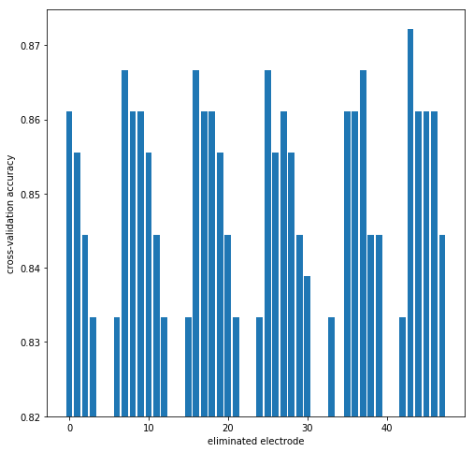
Backward Electrode Elimination: Case Study 1
Iteration 12
Removing electrode 43
unchanged baseline performance
Notes:
Simple Logistic Regression without optimized parameters using sklearn
https://scikit-learn.org/stable/modules/generated/sklearn.linear_model.LogisticRegression.html

Slide 77
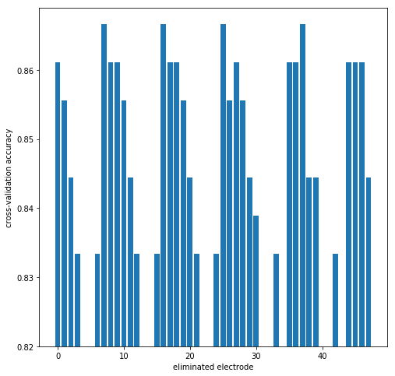
Backward Electrode Elimination: Case Study 1
Iteration 13
STOPPING HERE
removing any additional electrode would degrade performance.
unchanged baseline performance
Notes:
Simple Logistic Regression without optimized parameters using sklearn
https://scikit-learn.org/stable/modules/generated/sklearn.linear_model.LogisticRegression.html

Slide 78
Wrapper Methods - Variants
Backward feature elimination
Initialize the feature set F to include all features F₀: {f₀, f₁, …, , f_{M-1}} and evaluate performance
Evaluate performance with feature sets F\f_{i} , removing a single feature f_{i} from F.
Update F to exclude f_{i} for the one feature that maximally maintained or increased performance.
Repeat steps 2 and 3 until
Performance degrades
Target number of features is reached
Forward feature selection
Same in reverse: evaluate classifier with each feature individually, add feature and repeat.
Prioritized selection/ elimination
Add/ remove features in order determined by some feature scoring method.

Slide 79
Filtering vs. Wrapper
The main differences between the filter and wrapper methods for feature selection are:
Filter methods are much faster compared to wrapper methods as they do not involve training the models.
Filter methods measure the relevance of features by their correlation/ mutual information with dependent variable.
Wrapper methods measure the usefulness of a subset of features by actually training a model on it.
Filter methods use statistical methods for evaluation of features
Wrapper methods use cross validation.
Feature selection using wrapper methods risk making the model more prone to overfitting.

Slide 80
Embedding
Objectives with weight regularization favour solutions with specific weight characteristics.
L₁ regularization induces sparsity
L₂ regularization keeps weights near zero
Absolute value of the weights indicates classifier sensitivity to feature values.

Slide 81
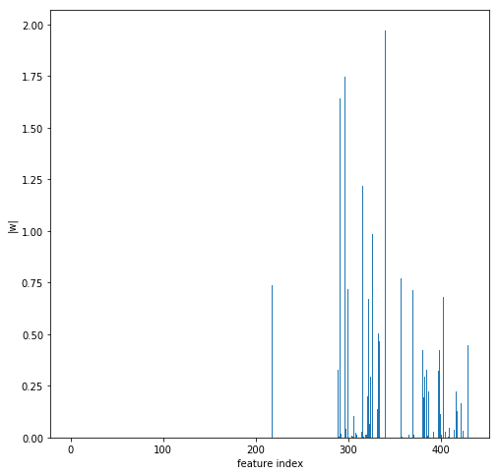
Embedding using L₁: Case Study 1
Notes:
Linear Regression with L1 penalty

Slide 82
Overview
Case Study 1
What is Feature Engineering?
Feature Selection
Filtering Methods
Wrapper Methods
Embedding Methods
Feature Extraction: Constructing Features Manually

Slide 83
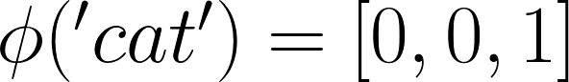
Tabular Data: Categorical Data
Categorical data cannot be interpreted by numerical models directly
Mapping onto numerical ‘index’ variables is problematic
Numbers are arbitrary, predictive function almost always non-linear in the mapping
Distance-based methods assume triangle inequality is valid
Transform categorical data into one-hot encoding
is_book
is_car
is_cat
Notes:
Tabular data often contains columns with categorical data: education, ethnicity, ...
Using one-hot encoding ensures that all categories are equally distant from each other

Slide 84
Tabular Data: Timestamps
Timestamps represented as seconds since 01.01.1970 UTC (UNIX Epoch)
Predictive functions are usually non-linear in raw timestamps.
Transforming the data into something more useful is trivial
Only retain time information that’s pertinent to your modelling problem.
Time of day (routines), day of week (restaurants), month (seasonal adjustment)
Rush hour yes/ no (traffic)
Time since last event (customer retention)
Time as an aggregator (spend per month; customer value)
Notes:
Event logs

Slide 85

Aggregation: Bag of Words
Notes:
Some data sources are variable in length: documents, songs, movies and you’d like to make a prediction for the whole item
Most common predictive models expect your data to have fixed dimensions
Limitations
Vocabulary: The vocabulary requires careful design, most specifically in order to manage the size, which impacts the sparsity of the document representations.
Sparsity: Sparse representations are harder to model both for computational reasons (space and time complexity) and also for information reasons, where the challenge is for the models to harness so little information in such a large representational space.
Meaning: Discarding word order ignores the context, and in turn meaning of words in the document (semantics). Context and meaning can offer a lot to the model, that if modeled could tell the difference between the same words differently arranged (“this is interesting” vs “is this interesting”), synonyms (“old bike” vs “used bike”), and much more.
More on document retrieval in other courses?
Further Reading
Code using sklearn
https://scikit-learn.org/stable/modules/classes.html#module-sklearn.feature_extraction.text
Information Retrieval
n-grams
Tf-idf
Word embeddings
Computer Vision
Hierarchical Bag-of-words
Fisher Vectors

Slide 86

Aggregation: Bag of Visual Words
Dictionary of K “visual words” often learned using K-means clustering
Notes:
A similar approach has been very popular in the Computer Vision community

Slide 87

Cropping: Sliding Window
Running/ Walking/ Cycling?
Notes:
Example: Data from a body worn accelerometer
How to classify what the wearer is currently doing?
Current action primarily depends on most recent data
Fixed length window looking fixed number of steps into the past should be sufficient
Allows to build datasets with lots of near i.i.d. samples from continuous recordings

Slide 88

Aggregation
Notes:
problem with temporal offset
Is temporal structure relevant?
How could we abstract this away
Further reading
http://citeseerx.ist.psu.edu/viewdoc/download?doi=10.1.1.725.908&rep=rep1&type=pdf

Slide 89

Aggregation: Empirical Cumulative Density Function
Notes:
Step 1: build empirical cumulative distribution function by sorting data in ascending order. Plotted over normalized interval [0, 1] yields empirical cumulative density function

Slide 90

Aggregation: Empirical Cumulative Density Function
Notes:
Step 2:

Slide 91

Aggregation: Empirical Cumulative Density Function
Notes:
Step 1: build empirical cumulative distribution function by sorting data in ascending order here, plotted over normalized interval [0, 1]

Slide 92

Aggregation: Empirical Cumulative Density Function
Notes:
Step 1: build empirical cumulative distribution function by sorting data in ascending order here, plotted over normalized interval [0, 1]

Slide 93

Aggregation: Empirical Cumulative Density Function
Notes:
Step 1: build empirical cumulative distribution function by sorting data in ascending order here, plotted over normalized interval [0, 1]

Slide 94

Aggregation: Empirical Cumulative Density Function
Notes:
Step 1: build empirical cumulative distribution function by sorting data in ascending order here, plotted over normalized interval [0, 1]

Slide 95

Aggregation: Empirical Cumulative Density Function
Notes:
Step 1: build empirical cumulative distribution function by sorting data in ascending order here, plotted over normalized interval [0, 1]

Slide 96

Aggregation: Empirical Cumulative Density Function
Notes:
Step 1: build empirical cumulative distribution function by sorting data in ascending order here, plotted over normalized interval [0, 1]

Slide 97


Normalization
Raw data value ranges can vary wildly.
Distances and objectives become governed by features with large values
Standardisation
Min-Max normalization
Scaling to unit length
Notes:
Standardisation is by far the most commonly used technique (seen in regression)
Min-max scaling sometimes performs better, depending on data distribution
Scaling the feature vector to unit length is often only done with histograms (e.g, turning word counts into frequencies)

Slide 98
Projection
How much of the input space does the data occupy?
Set of face images among all possible images of 100 x 100 pixels.
Set of English language utterances among all possible 16kHz audio.
Set of human hand gestures among all possible 2 second accelerometer data.
Projection Methods
PCA
SVD
Randomized variants
See also non-linear projection methods (e.g., autoencoders)

Slide 99


Projection: Principal Component Analysis (PCA)
https://stats.stackexchange.com/questions/2691/making-sense-of-principal-component-analysis-eigenvectors-eigenvalues
Notes:
You’ve seen principal components analysis earlier. Here is an example for how it can be used in practice.
Imagine you had a database of face images, each 100x100 pixels. Concatenating all pixels into one long row would give you one 10k dimensional feature vector for each image.

Slide 100


Eigenfaces
Top Eigenvectors (Eigenfaces)
Mean Face
Notes:
The image on the right shows the 36 principal directions of variance across a dataset of aligned face images.

Slide 101


Eigenfaces
Encoding
= + 0.8 + -0.2 + …
Faceness of an image (reconstruction error)
Recognition (nearest neighbour)
Classification (via attribute labels)

Slide 102

PCA: Case Study 1
Notes:
See https://scikit-learn.org/stable/modules/generated/sklearn.decomposition.PCA.html#sklearn.decomposition.PCA

Slide 103

PCA: Case Study 1
Notes:
See https://scikit-learn.org/stable/modules/generated/sklearn.decomposition.PCA.html#sklearn.decomposition.PCA

Slide 104
Summary
Feature Selection: discarding a subset of features
Filtering: feature ranking, keeping top k
Wrapper Methods (greedy forward/ backward selection)
Embedded methods (LASSO)
Feature Extraction: manually constructing new features
(dis)aggregation
binarization
one-hot encoding,
Bag-of-Words,
Empirical Cumulative Density Function (ECDF)
normalization
projection

Slide 105
Summary
Case Study 1: Prediction Central Neuropathic Pain
What is Feature Engineering?
Transforming data to facilitate downstream machine learning tasks
Feature Selection: Finding Relevant Subsets of Features
Filtering Methods (rank features, keep top k)
Wrapper Methods (greedy forward/ backward selection)
Embedding Methods (LASSO)
Feature Extraction
Tabular Data Transformations (binarization, one-hot encoding)
Cropping (temporal sliding windows)
Aggregation (Empirical Cumulative Density, Bag-of-Words)
Normalization (e.g., standardisation, scaling)
Projection (PCA)

